Slide 1
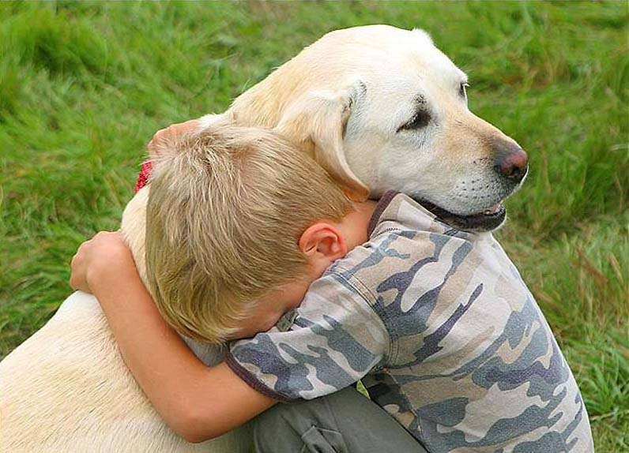
Working with animals at school
Moments of pet therapy

Slide 2
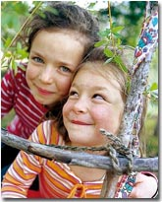
IC VANVITELLI CASERTA
I’m a special education teacher who supports children with special needs.
Special needs children are a great resource for our school.
We work hard for their well-being.
I love my job: I like seeing smiles on
their faces.

Slide 3
PET THERAPY WITH OUR SPECIAL CHILDREN …. AT SCHOOL WITH TOBIA

Slide 4
LET’S GET FRIENDS!

Slide 5
Tobia is a beautiful Labrador example, domesticate to stay with children. His docile nature and his joyful character allow him to impart peace of mind and tranquility to children.

Slide 6
Look how to look after me !

Slide 7
Do not be afraid: Let’s look at my eyes!

Slide 8
Working with Tobia was a beautiful experience. Children have calmed themselves down and even who was afraid finally approached and pet him.

Slide 9
The main aim for special needs children is the integration into the group, thus increasing their physical and cognitive individual abilities.

Slide 10
General objectives:
To acquire new cognitive and behavioral motor skills.
To increase self-esteem and respect towards the others’ differences.
To improve communication skills and socialization.
To increase the listening ability and attention.
To stabilize mood and emotions.
To stimulate curiosity and knowledge of the outside word.
To increase the ability of using the five senses in an integrated way.

Slide 11
THANKS FOR PAYING ATTENTION
Ornella Zuccaro
IC VANVITELLI

