Slide 1
Finnish school system

Slide 2
Education system
Basic education 6+3 years
Vocational school or upper secondary school (Forssan yhteislyseo)3 years

Slide 3
Upper secondary schools (lukio, Forssan yhteislyseo in the city of Forssa)
C. 50 % of students
provide sufficient capabilities for further studies (universities, universities of applied science)

Slide 4
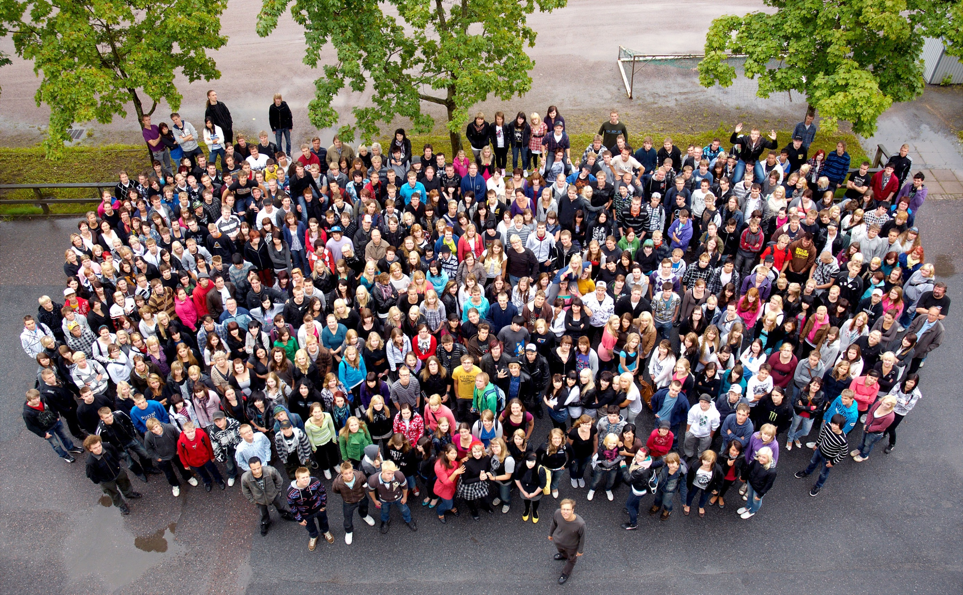

Slide 5
Upper secondary schools
2-4 years of studies
Education is free (incl. lunch)
Students pay for study books, laptops and transportation
Finnish students are highly motivated and persistent with a lot of freedom to choose their path of study!

Slide 6
National matriculation examination
Schooling ends with the national matriculation exams.
Mother tongue =Finnish (separate test for immigrants) is the only compulsory test for all the students.
Swedish, Math, Foreign language (English), General Studies (Humanities and Natural Sciences, e.g. Biology): A student selects three tests.
Optional tests e.g. in languages. Students normally take 4-7 tests in all.

Slide 7
Forssa Upper Secondary School
www.forssanyhteislyseo.fi
Principal PhD, MBA simo.veistola@forssa.fi, p. 00358505640057

Slide 8
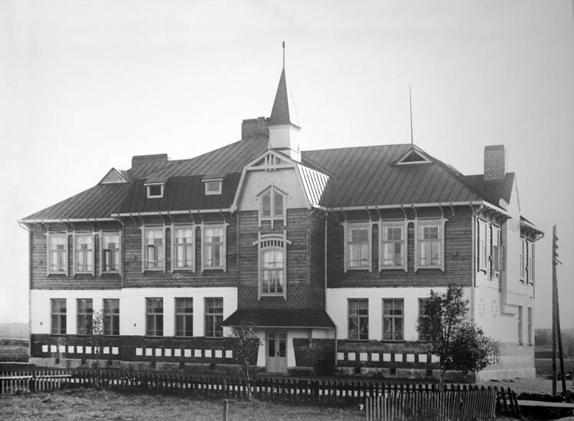
History
The Upper Secondary School of Forssa (Forssan yhteislyseo) was established in 1899, thus being the oldest rural secondary school in Finland

Slide 9
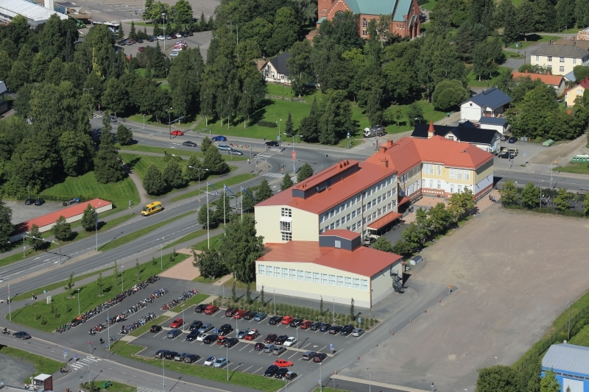

Slide 10
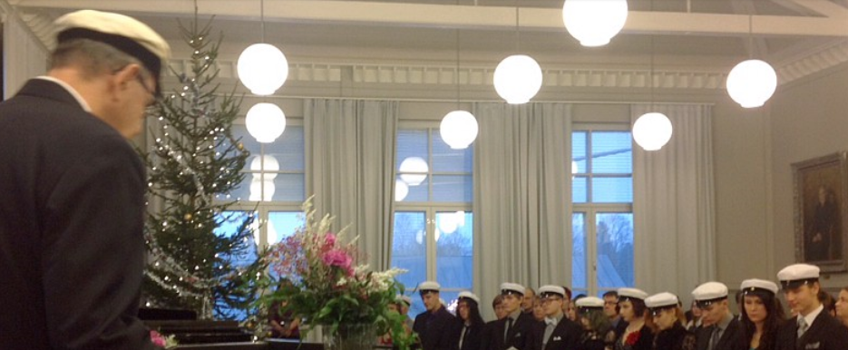
Nowadays
Forssa Upper Secondary School is a compact and safe environment to study.
The building has been totally renovated some years ago.

Slide 11
Students and teachers
Forssan yhteislyseo has about 500 + 100 students.
The staff includes 35 teachers.

Slide 12
Languages
Forssan yhteislyseo offers a wide selection of courses in different languages, such as Swedish, English, German, French, Russian, Italian and Spanish.

Slide 13
ICT in Forssan yhteislyseo
Three laboratories are equipped with 80 computers (Linux) for our 500 students to use freely.
All students bring their own laptop or tablet.
Each classroom has got a Smartboard at the teacher's disposal.
The learning platform Peda.net and interactive e-study books are used in many subjects.

Slide 14
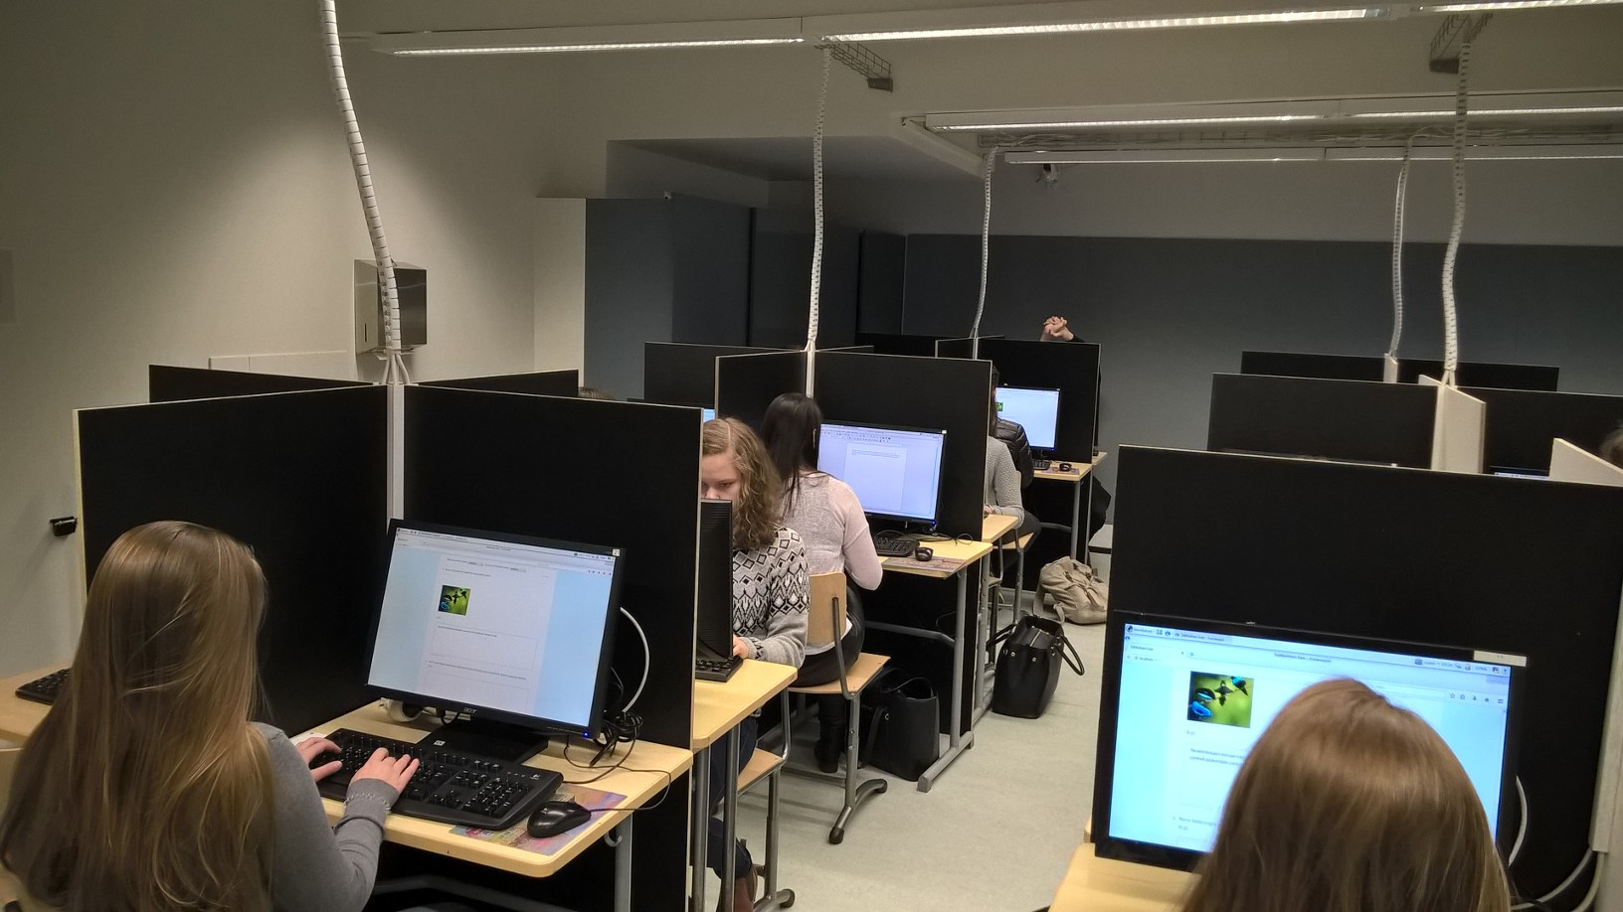

Slide 15
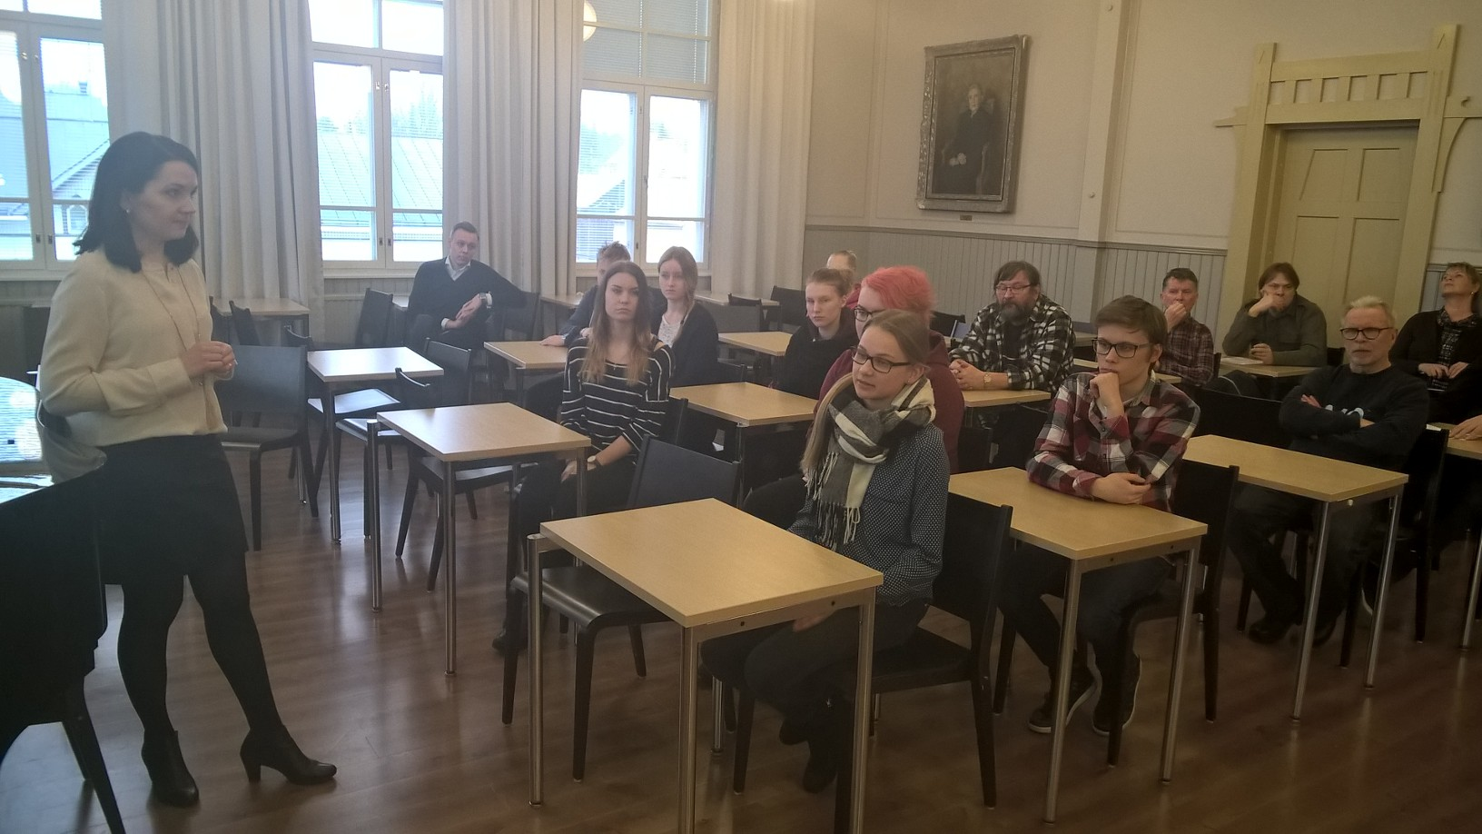
Studies

Slide 16
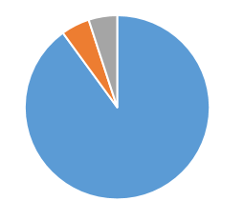
Syllabus
is designed to last three years, but students may complete it in from 2 to 4 years.
75 courses are needed to receive a school-leaving certificate. Normally it takes three years.

Slide 17
Compulsory subjects
Mother Tongue (Finnish) 6 courses
Foreign Language (English) 6 courses
3) 2nd National Language (Swedish) 5 courses
4) Math (Basic or Advanced) 6-10 courses

Slide 18
Compulsory subjects
Physics, Chemistry, Biology, Geography, total 5 courses
History and Social Studies, total 6 courses
Religion, Philosophy and Psychology, total 5 courses
Health Education, 1 course

Slide 19
Compulsory subjects
Art, 2 courses
Music, 2 courses
Physical Education, 2 courses
Studies Counselling, 2 courses

Slide 20
Studies in upper secondary schools
- Five study periods
75 courses (1710 minutes, 3*75 min in seven weeks)
7 d test ”weeks”, one test / day
1. autumn
1. spring
1. period
2.
3.
4.
5.
August
Sep
Oct
Nov
Dec
Jan
Feb
Mar
Apr
May
Test week

Slide 21
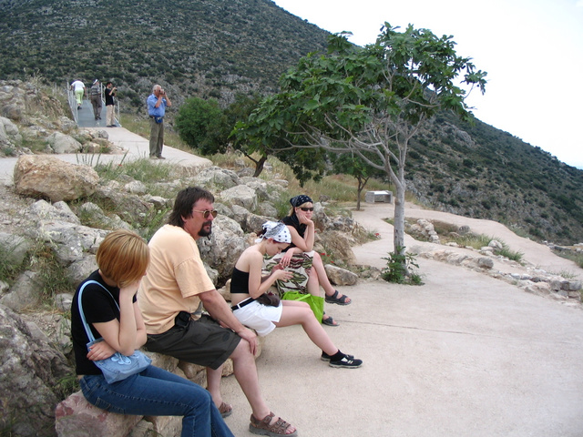
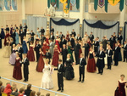
Optional and voluntary studies
Further applied courses in every subject
E.g. languages: German, French, Russian, Italian, Spanish
Theme Studies
Drama, Sports Academy courses etc.
There are more than 300 courses available in FYL.

Slide 22
Students in Forssan yhteislyseo
Highly motivated to continue their studies in the university or university of applied sciences after upper secondary school studies
Well-equipped with working life skills, such as multiliteracy, linguistic competence, mathematical and social skills plus digital competence

Slide 23
