Slide 1
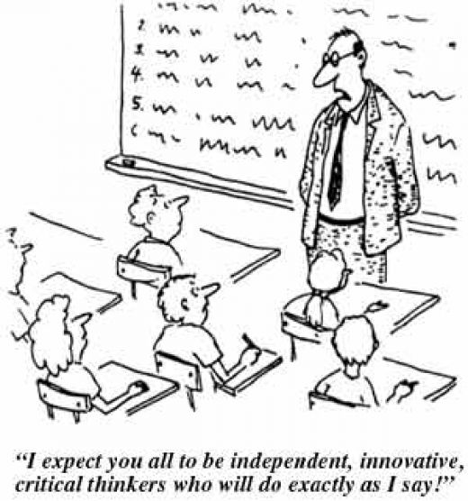
Innovative approaches to teaching By Kamila Karagavrilidisova
karagios@gmail.com

Slide 2
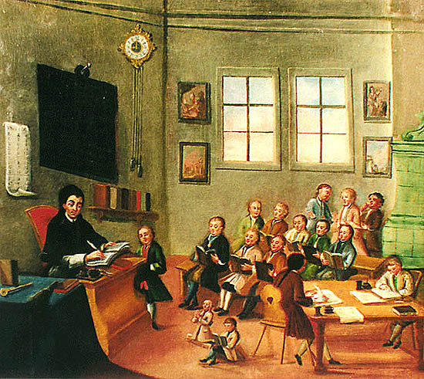
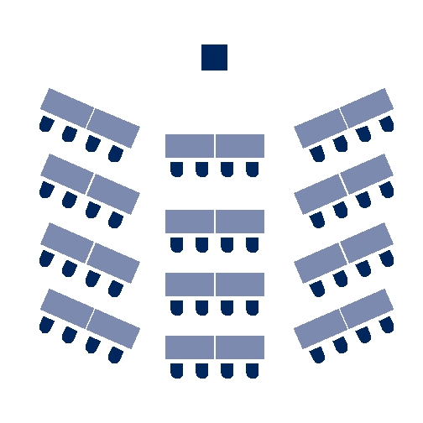
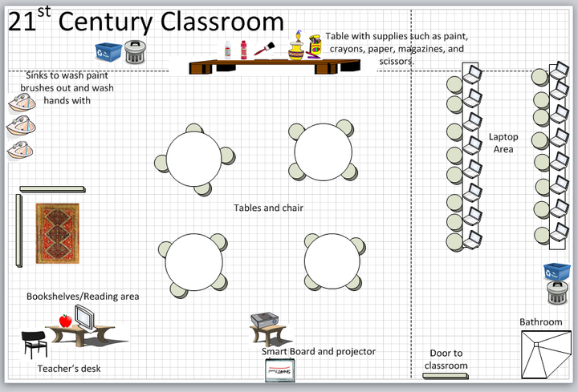

Slide 3
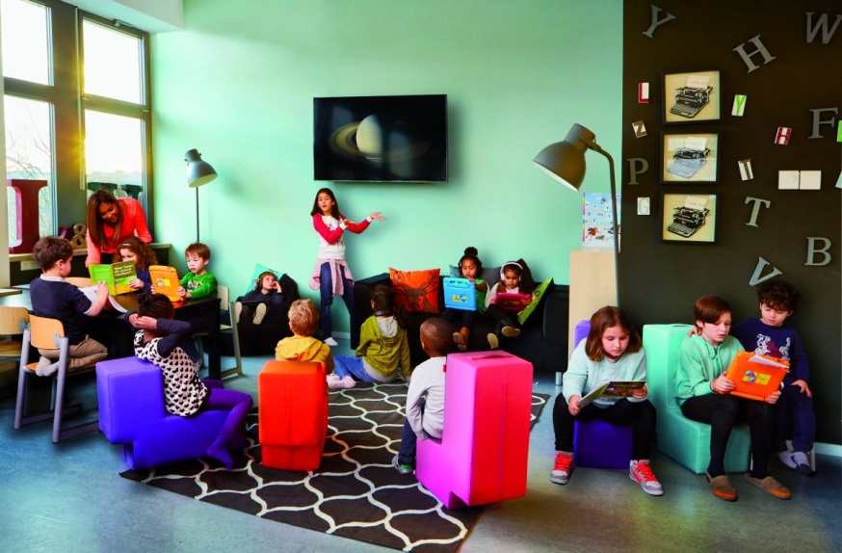
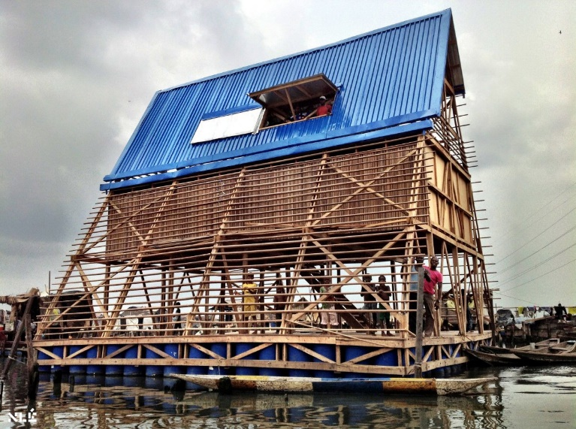
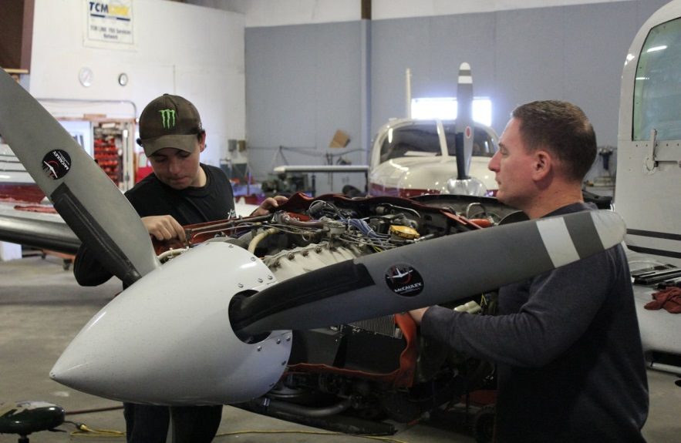
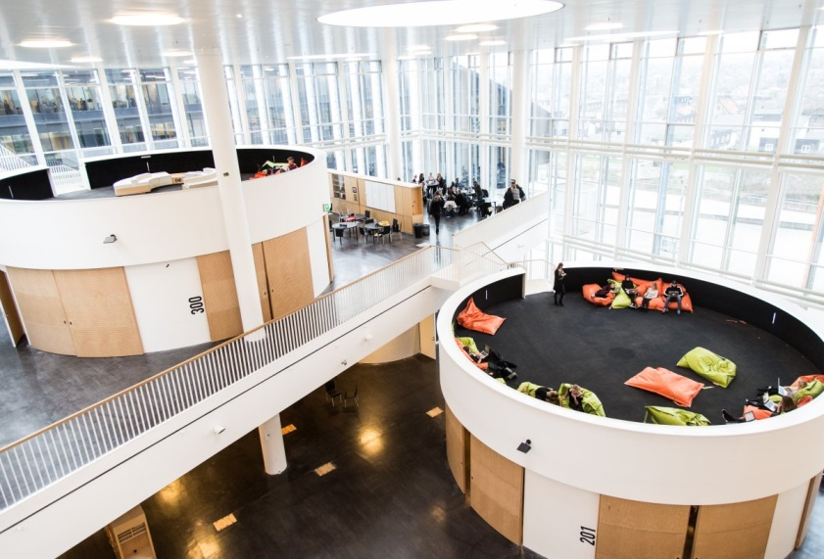
http://www.businessinsider.com/the-13-most-innovative-schools-in-the-world-2015-9
Steve Jobs School
NLE – Makoko Floating School
Big Picture Learning. Providence
Mathias Eis Schultz
Future of Learning_Video

Slide 4
Global awareness
Creativity
Environmental and civic literacy
Health and wellness awareness
Leadership skills
Social responsibility
Critical thinking
Personal productivity
Contextual learing skills
Media literacy skills

Slide 5
“It is particularly important teachers do not view 21st century skills
as an additional ‘subject,’ but rather as skills to be integrated across
all curricula”

Slide 6
Project Based Learning is a teaching method in which students gain knowledge and skills by working for an extended period of time to investigate and respond to a complex question, problem, or challenge.
Essential Elements of PBL
Significant Content - important knowledge and skills, derived from
standards
21st century competencies -build competencies valuable for today’s
world
Voice and Choice – time/task management guided by teacher
Critique and Revision - give and receive feedback – further inquiry
Driving (Open ended) Question – using recourses, developing answers
Public Audience – presentation beyond their classmates/teacher

Slide 7
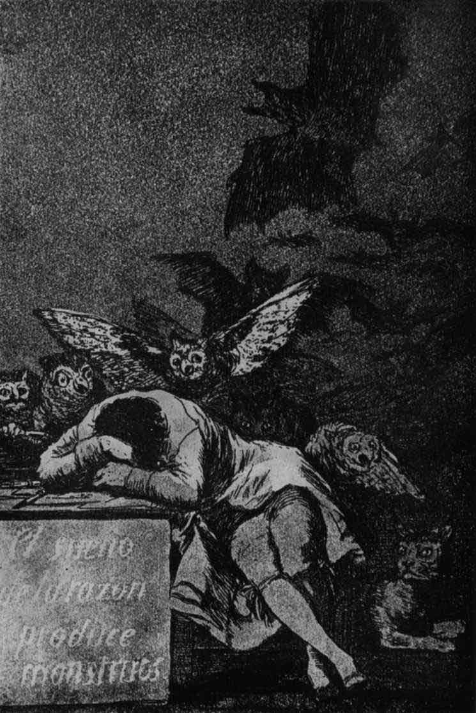
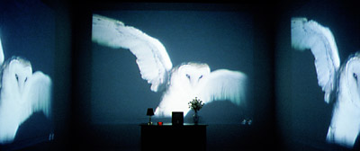
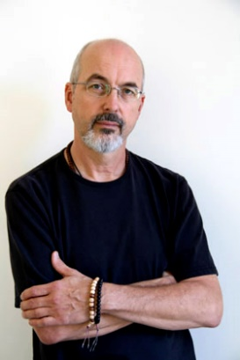
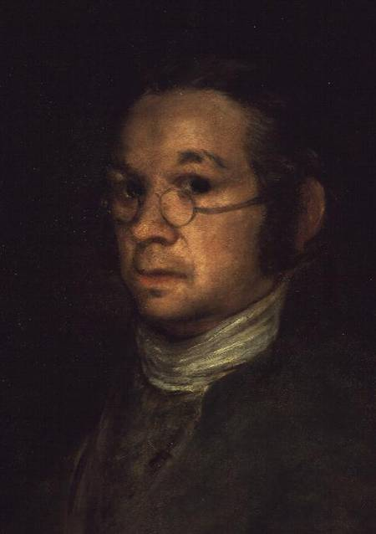
Case Study: Primary school – Prague (PBL_Classroom example) Content: New Media Art
Core subjects: Visual Arts / ICT Age group: 5th grade
Digital media are rarely used as creative tools.
1798
1988
The sleeping of reason - F. Goya/B. Viola
Viola‘s interpretation of Goya‘s artwork well demonstrates how the similar ideas can be captured differently. Traditional vs. New Media - list the difference/similarities, talk about it in groups etc.

Slide 8
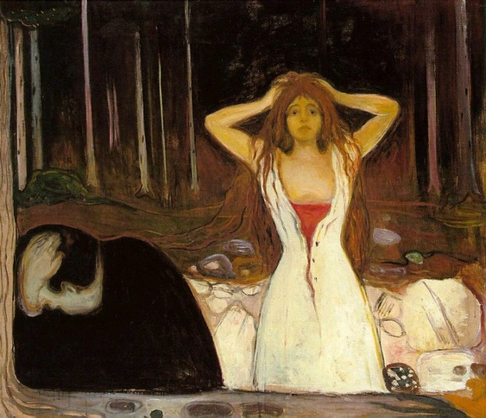
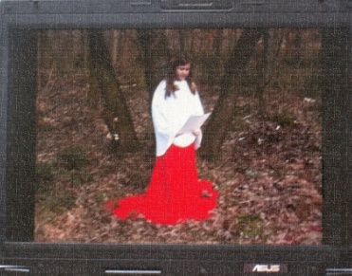
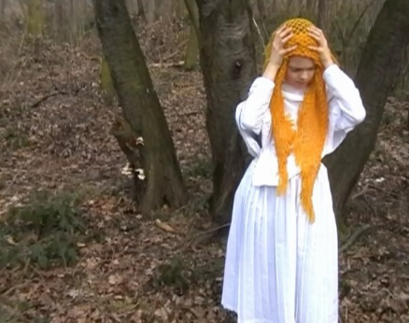
What is the story about? Interpret this „classical“ artwork anew by using variety of media.
With your group prepare/design a proposal for gallery art instalation.
E. Munch – Ashes 1894
Oh no! What have I done!
Once upon a time a woodcutter went into the forest…
Team 1:
Google searched the photos and then created a story based on the painting using the PowePoint.
Team 2:
Came up with another story which was „performed“ and video recorded in the woods.
Team 3:
Comic book interpretation.

Slide 9
PBL – Example of complex questions
Are robots friends or foes?
How do stories from the past define who we are today?
What new monument or museum should be built in our city to enhance the lives of our citizens and visitors?
How can we create a more sustainable and efficient modern ecosystem?
How can we manage scarcity?
How can we create "farm to table" at our school during the winter months?
How can we build community through art?
How can we make getting around in the winter more safe and convenient?
How can we prevent E. coli from entering our swimming areas?
I what ways can I change the injustices I witness?
What's the fastest and cheapest way for me to get to school on time?
How can we make life sweeter in our community?
How can we use our knowledge of math to convince our families, our school, and our community to go solar?
Good projects start with good questions/complex problems. They should be relevant to the current student‘s interests and needs and linked directly to the real life!
Projects can be from very small to large scale. (1 day, 1 year../
1 or more collaborating teachers/ within the classroom /schools – extending to the community level or even further…)

Slide 10
WHEN?
WHERE?
WHAT?
HOW?
WHAT IF?
FOR WHAT REASON?

Slide 11
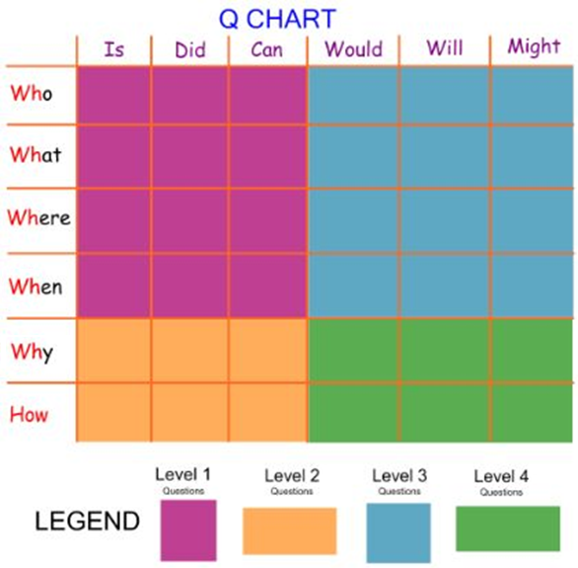

Slide 12
DICE METHOD
1. Describe
(what do you see…)
2. Compare
(similar to, different from…)
3. Associate
(what comes up to your mind when…)
4. Analyze
(single components…)
5. Apply
(how can you use it…)
6. Argument
(good/bad, like/dislike – support your arguments…)

Slide 13
CLASSROOM VISIT
http://www.branajazyku.cz/english
3A METHOD
Annotation (Abstract) – provide the background info (goal, age of students, time…)
Analysis – of the video (problematic section…). What methods did you use to achieve the goal? Did students use higher order thinking skills? Were the tasks appropriate according to students needs?
Alternation – sharing the ideas, what could be done next time....

Slide 14
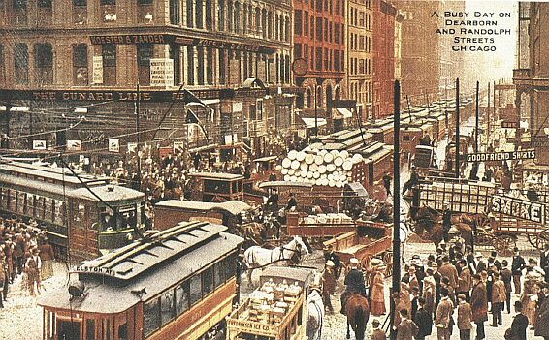
Imagine you live in a Chicago of the 19th century and
you are asked to spend financial resources on one
programme. What area would you focuse on?
https://www.youtube.com/watch?v=5p3RAkRNLpU

Slide 15
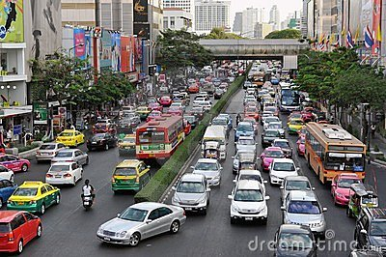
Problem-solving task
Think of a town centre where there is too much traffic. In twos, think of three alternative solutions to this problem. List the advantages and disadvantages of each alternative. Then decide which alternative would be the cheapest one, the most innovative one, the most environmentally friendly one. Report your decisions to another pair / group / the class, and discuss with them which solution would be the best one to put forward to the local government.

Slide 16
‘PLANNING A CLASS NIGHT OUT'
Criteria for your task – questions you should ask yourself:
Does the activity engage learners' interest?
Is there a primary focus on meaning?
Is there a clear goal or an outcome?
Is success judged in terms of outcome?
Is completion a priority?
Does the activity relate to real world activities?'
I think the lesson would certainly engage my learners' interest, especially if they knew they would actually be going on the chosen night out, so Yes.
Learners have strong preferences about nights out and would definitely be meaning what they say, so Yes
The first outcome for each pair is their finished plan for the night out, (which must be complete before they tell the class about it so the class can vote on the best plan) and a second outcome might be the real-world night out, so a confident Yes to 3-6)
Click for the Lesson Plan_Planning a Class Night Out
TBL: Lesson Examples and Analysis - The Budget and The Interview
https://www.teachingenglish.org.uk/article/task-based-speaking
https://www.teachingenglish.org.uk/article/criteria-identifying-tasks-tbl

Slide 17
Inside/Out
JR Video
Language teachers! This might be of your interest☺
Community Based Learning
Inspirational Talks_Subtitles available :)
http://bie.org/
PBL_Dos Pueblos Engineering Academy
Link
Inspirational personality and movie! Education in extreme conditions of India made possible!
Cyril Mooney
http://prezi.com/-dmr8klvqniy/?utm_campaign=share&utm_medium=copy&rc=ex0share
http://prezi.com/gbarkem_g3ji/?utm_campaign=share&utm_medium=copy&rc=ex0share

Slide 18
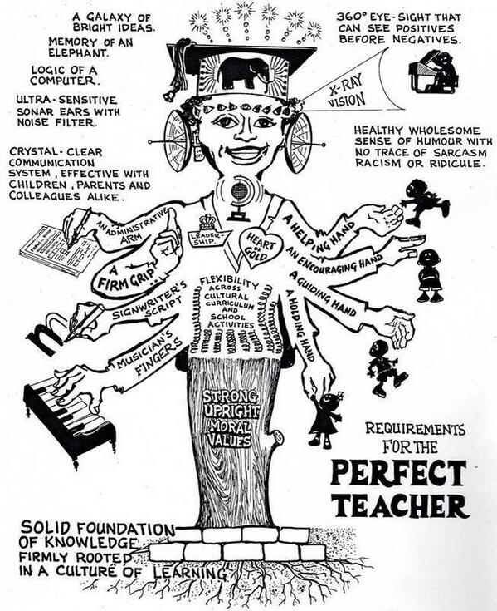
Thank you! ☺

