Slide 1
Project Based Learning is a teaching method in which students gain knowledge and skills by working for an extended period of time to investigate and respond to a complex question, problem, or challenge.
Essential Elements of PBL
Significant Content - important knowledge and skills, derived from standards
21st century competencies -build competencies valuable for today’s world
Voice and Choice – time/task management guided by teacher
Critique and Revision - give and receive feedback – further inquiry
Driving (Open ended) Question – using recourses, developing answers
Public Audience – presentation beyond their classmates/teacher

Slide 2
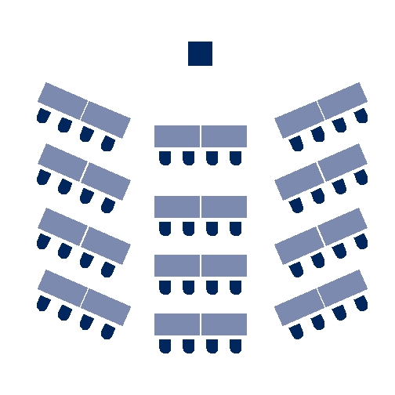
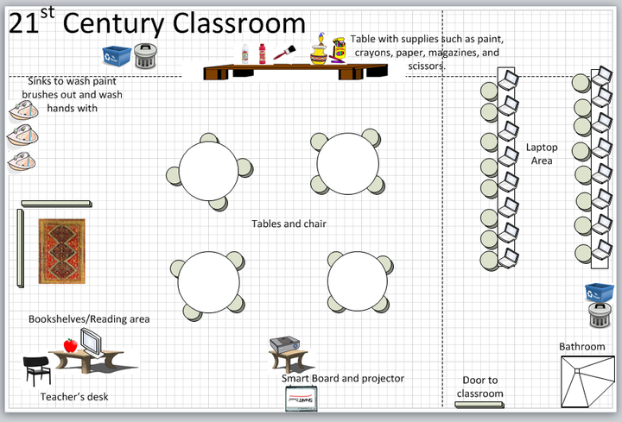
The Types of Grouping:
Traditional vs. „21st century classroom“ where the setting is prepared for the work in the teams and also suggests the students empowerment. Reorganization of the classroom can never guarantee a positive change if not well managed.
Proximity
Random (1,2,3…)
Friendship
Achievement/Experience
Deliberate (peer tutoring)
Interest/By choice/Task

Slide 3
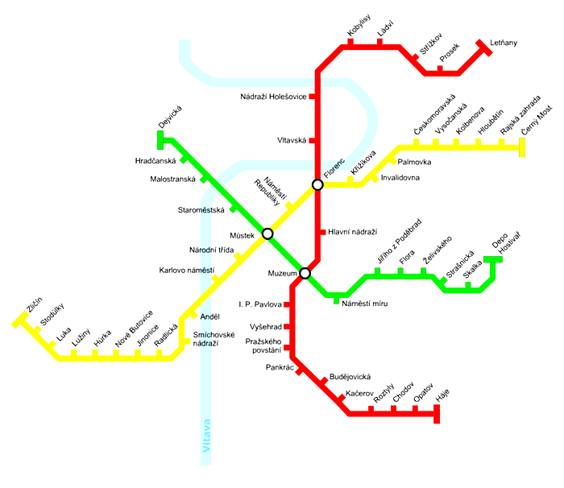
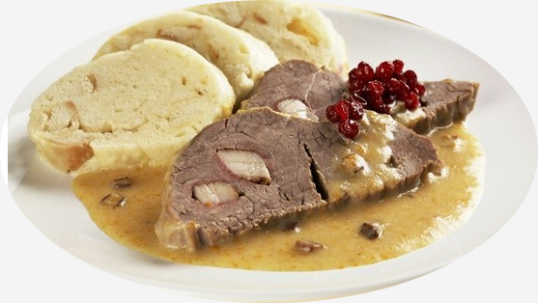
PROJECT TITLE: ALTERNATIVE/HONEST PRAGUE EXPERIENCE
PROJECT GOAL: CREATE A TOURIST GUIDE BROCHURE

Slide 4
RECOMMENDED TIPS, LINKS AND AREAS YOU CAN USE/FOCUSE ON:
http://pragulic.cz/?lang=en
EXPERIENCE PRAGUE THROUGH THE EYES OF HOMELESS PEOPLE
http://www.praguealternativetours.cz/
PRAGUE ALTERNATIVE WALKING TOURS
http://www.pragtique.cz/en/homepage-en/
UNIQUE AND HIGH-QUALITY GIFTS WITH A PRAGUE THEME
YOUTUBE VIDEO(S) – „HONEST GUIDE“ - PRAGUE

Slide 5
And here are some examples of what you have created. Thank you for collaboration ;)
https://www.canva.com/design/DACWVL_wi2M/JG-MmSvIonoZDneibRF0Jg/view

Slide 6
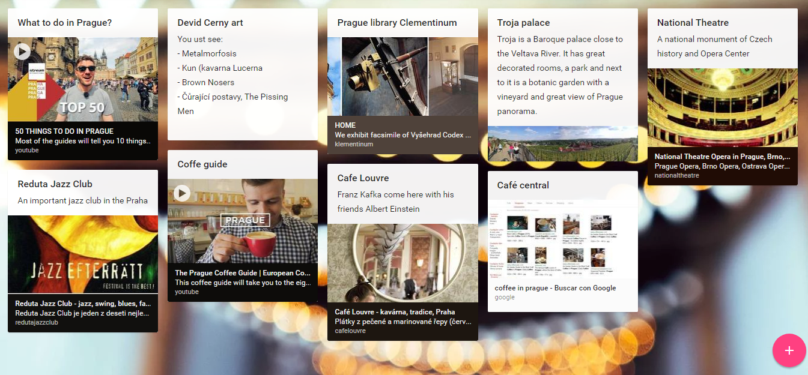
https://padlet.com/jmunozreguero1/eq613uvuch

Slide 7
Project Design - Checklist:
Try to ask yourself following questions before you start the project with your students.
1. Is the central question open-ended, understandable and inspiring to students?
2. Is the project goal focused on a central question, at the appropriate level
of challenge?
3. Is the project derived from standard? (skills, understanding, knowledge).
4. Is the project inquiry student driven? (students will generate questions,
gather & interpret data throughout the project).
5. Is the project context authentic - does it involve real-world tasks, tools, makes a real impact on the world, and/or speaks to students’ personal concerns, interests, or identities?
6. Does the project include critical thinking/problem solving, collaboration,
and self management skills?
7. Is students work made public by presenting or offering it to people beyond
the classroom?

Slide 8
PBL EXAMPLE OF COMPLEX QUESTIONS/PROBLEMS
Are robots friends or foes?
How do stories from the past define who we are today?
What new monument or museum should be built in our city to enhance the lives of our citizens and visitors?
How can we create a more sustainable and efficient modern ecosystem?
How can we manage scarcity?
How can we create "farm to table" at our school during the winter months?
How can we build community through art?
How can we make getting around in the winter more safe and convenient?
How can we prevent E. coli from entering our swimming areas?
I what ways can I change the injustices I witness?
What's the fastest and cheapest way for me to get to school on time?
How can we make life sweeter in our community?
How can we use our knowledge of math to convince our families, our school, and our community to go solar?
Good projects start with good questions. They should be relevant to the current student‘s interests and needs and linked directly to the real life!
Projects can be from very small to large scale. (1 day, 1 year../1 or more collaborating teachers/ within the classroom – extending to the community level or even further…)

Slide 9
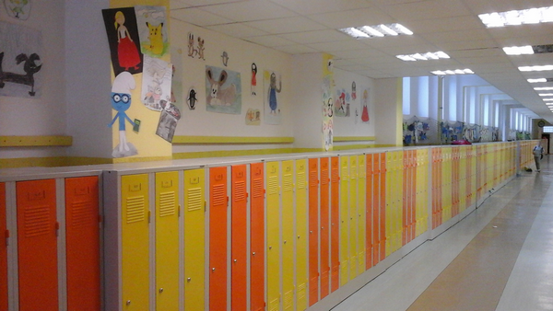
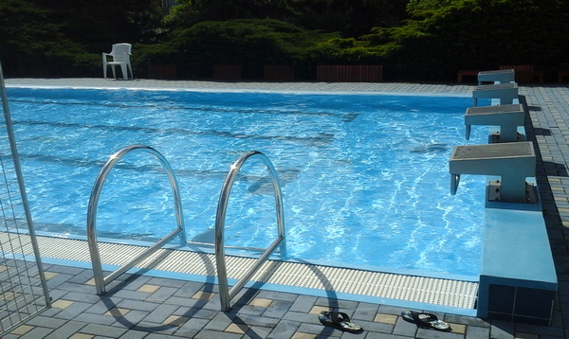
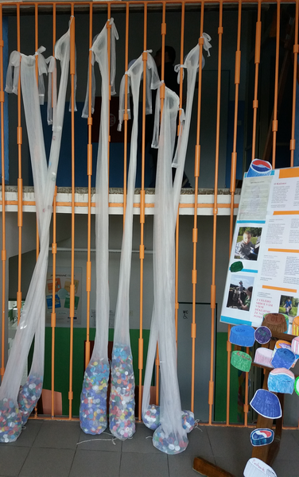
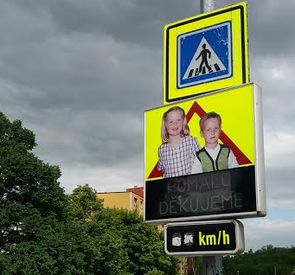
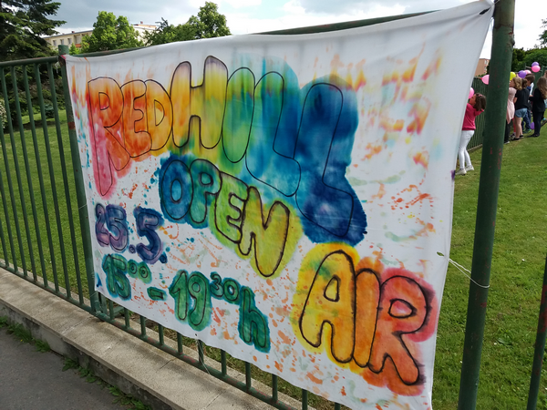
http://www.zscvrch.cz/
SCHOOL VISIT
And some of your favourite pictures ☺

Slide 10
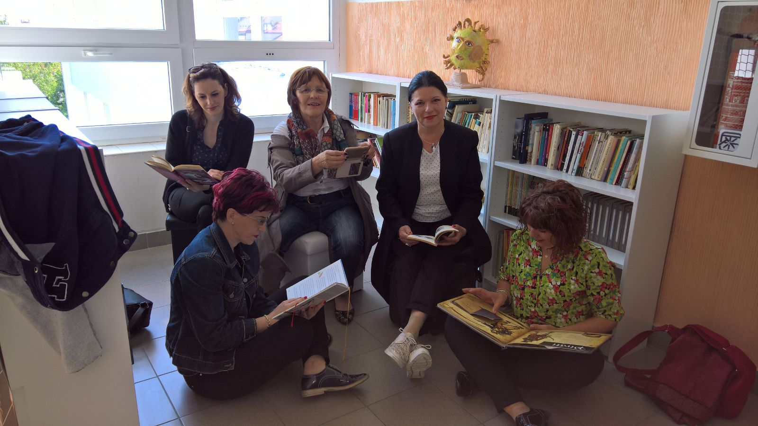
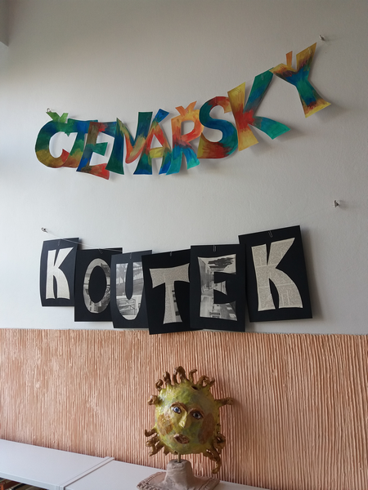
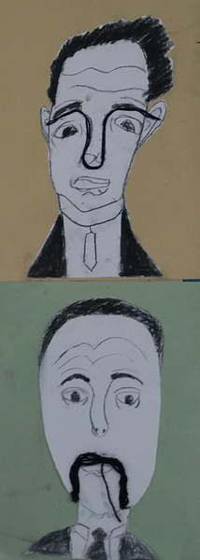
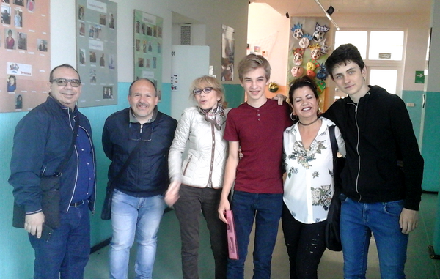
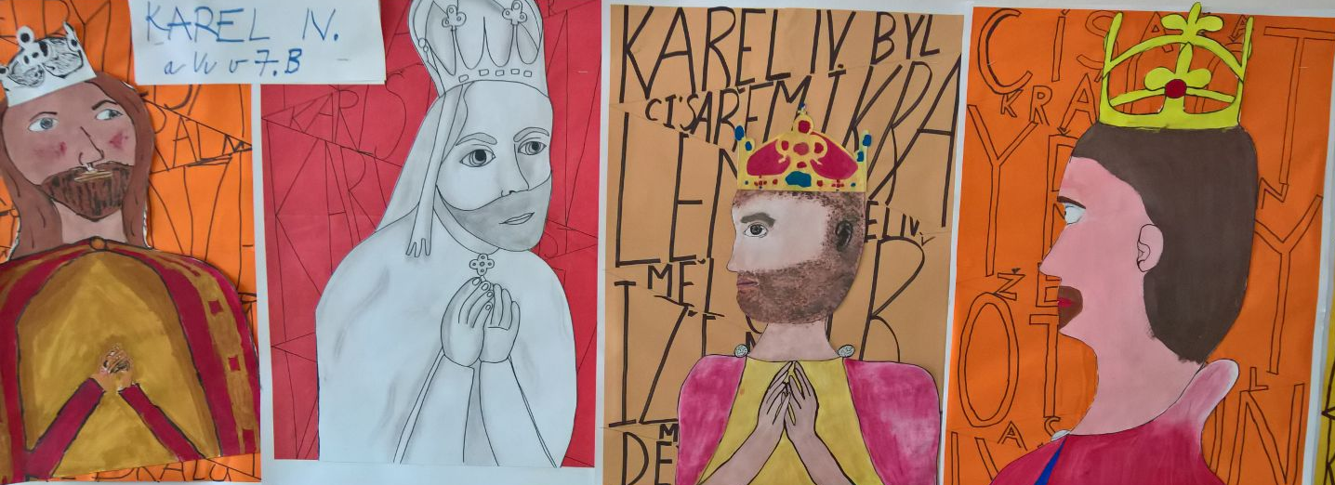
Reading corner

Slide 11
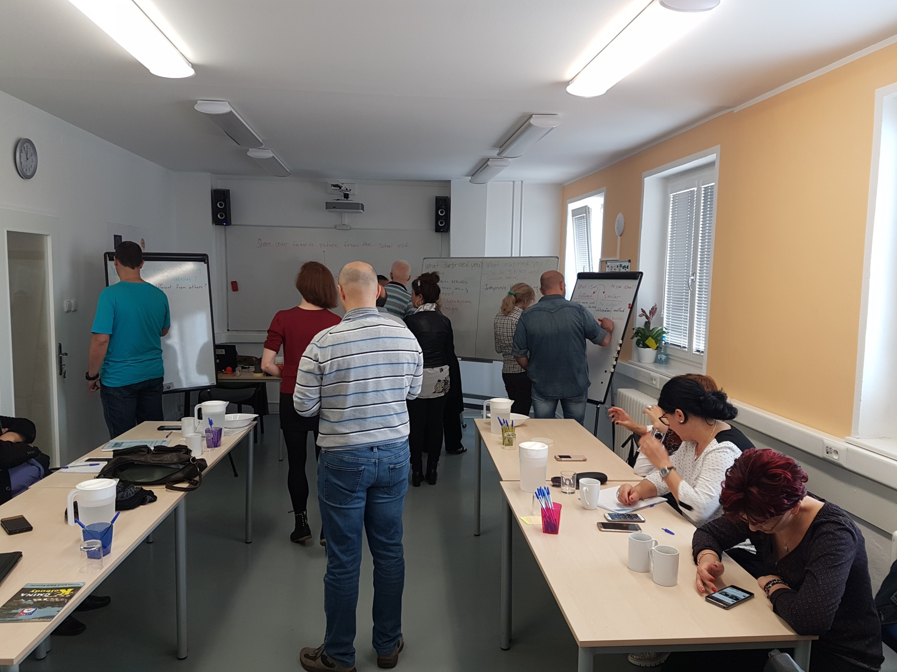
Follow up after school visit

Slide 12
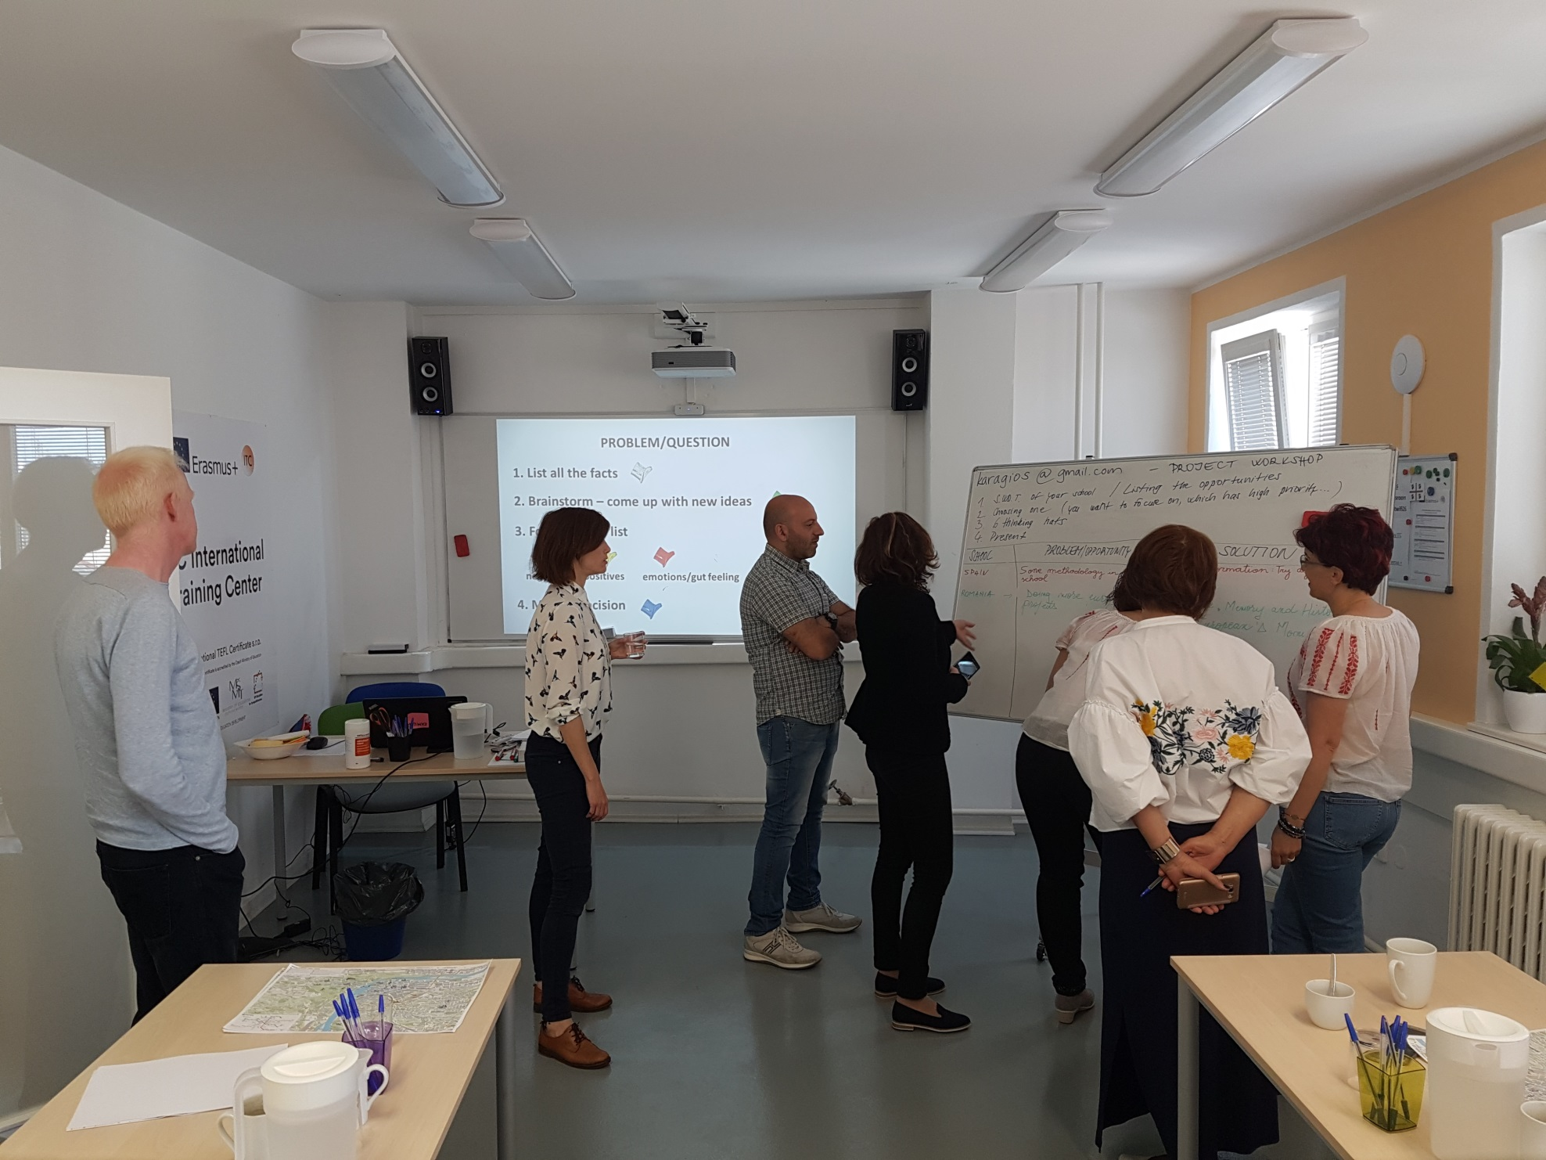
FINAL PROJECT WORKSHOP

Slide 13
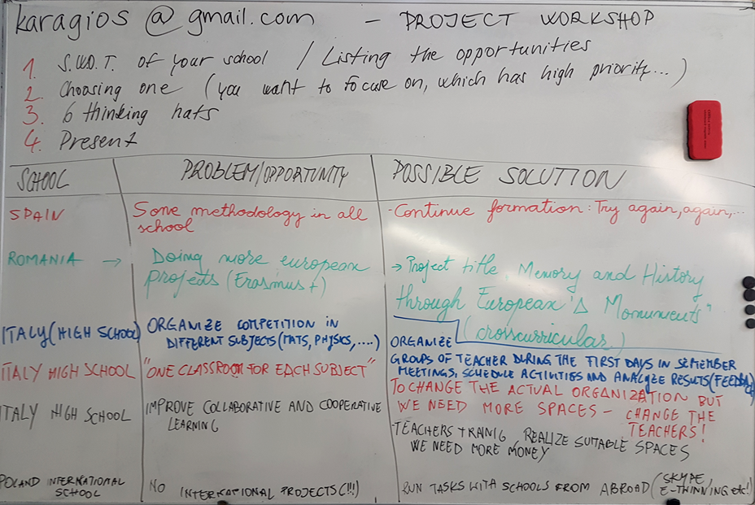

Slide 15
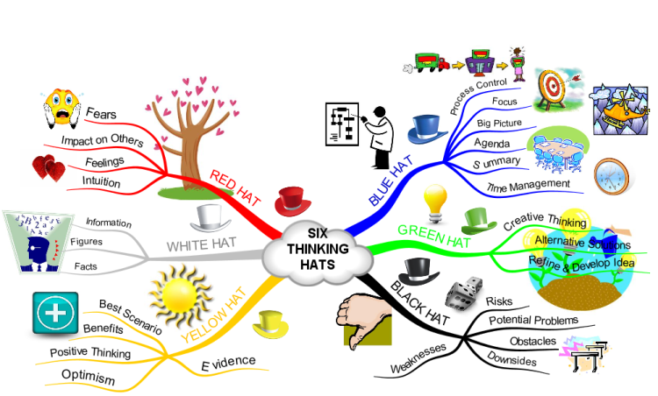
Edward de Bono

Slide 16
PROBLEM/QUESTION
1. List all the facts
2. Brainstorm – come up with new ideas
3. For each idea list
negatives
positives
emotions/gut feeling
4. Make a decision

Slide 17
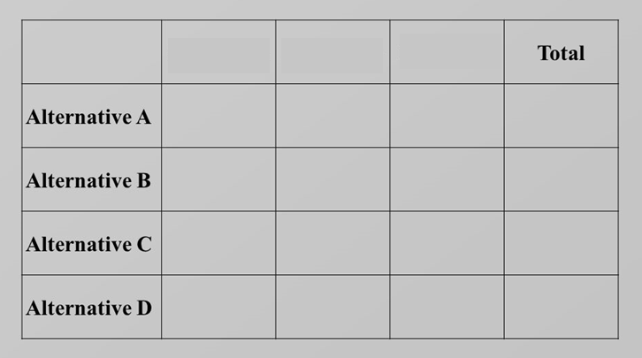
SFF Matrix: Suitability, Feasibility and Flexibility
Criter. 1
Criter. 2
Criter. 3

Slide 18
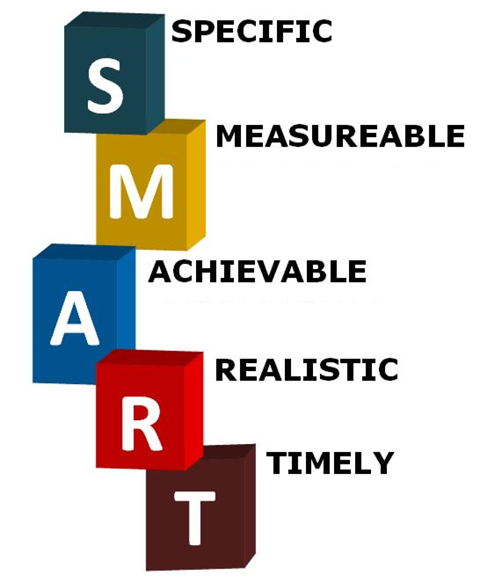
Example: A general goal would be, “Get in shape.” But a specific
goal would say, “Join a health club and workout 3 days a week.”
Establish concrete criteria for measuring progress toward the attainment of each goal you set. Example: How will I know when it is accomplished?
Plan your steps wisely. An achievable goal will usually answer the question
How? How can the goal be accomplished?
A goal toward which you are willing and able to work. It can be both high and realistic. Low goal applies low motivational force!
Ground the goal within a time frame. A commitment to a deadline helps a team focus their efforts on completion of the goal on or before the due date

Slide 19
http://www.gimprilep.edu.mk/
Links from you and some from me
http://www.liceomotzo.gov.it/index.php?c=3
https://elauladeangel.wordpress.com/
http://www.liceomotzo.gov.it/index.php?c=3

Slide 20
Inside/Out
JR Video
http://www.keyprojects.eu/
Community Based Learning
http://bie.org/
Inspirational Talks_Subtitles available :)
http://pblchecklist.4teachers.org/checklist.shtml
STEM to STEAM movement + PBL academy in the US
http://rubistar.4teachers.org/index.php
PBL_Dos Pueblos Engineering Academy
Link
Inspirational personality and movie! Education in extreme conditions of India made possible!
Cyril Mooney
http://prezi.com/-dmr8klvqniy/?utm_campaign=share&utm_medium=copy&rc=ex0share
http://prezi.com/gbarkem_g3ji/?utm_campaign=share&utm_medium=copy&rc=ex0share

Slide 21
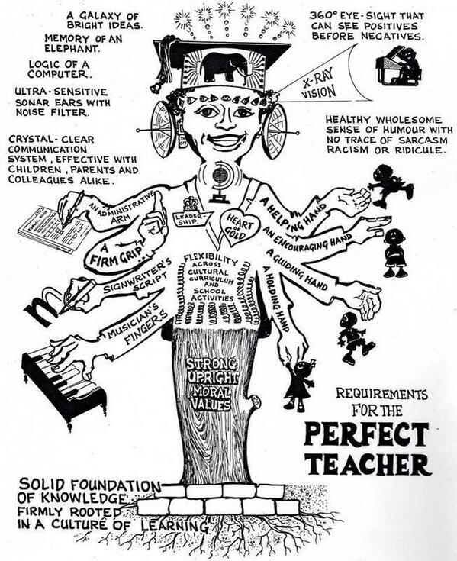
Thank you! ☺

