Slide 1
Dealing with multicultural CLass
Petra Vallin

Slide 2
Multicultural education
What is multicultural education?
Why shall we do it?
How can we carry it out?

Slide 3
TASK 1:
Walk around the classroom and read all the definitions of „multicultural education“. Choose ONE which represents YOUR own approach to „multicultural education“. Stand next to the definition which you prefer.

Slide 4
Definition
„Multicultural education refers to any form of education or teaching that incorporates the histories, values, beliefs, and perspectives of people from different cultural backgrounds. At the classroom level, for example, teachers may modify lessons to reflect the cultural diversity of the students in a particular class. In many cases, “culture” is defined in the broadest possible sense, encompassing race, ethnicity, nationality, language, religion, class, gender, sexual orientation, and “exceptionality”—a term applied to students with specialized needs or disabilities.“
(The Glossary of Education Reform, available on http://edglossary.org/multicultural-education/)

Slide 5
Multicultural vs. Intercultural education
„Multicultural education uses learning about other cultures in order to produce acceptance, or at least tolerance, of these cultures. Intercultural Education aims to go beyond passive coexistence, to achieve a developing and sustainable way of living together in multicultural societies through the creation of understanding of, respect for and dialogue between the different cultural groups.“ (UNESCO Guidelines on Intercultural Education, available on http://unesdoc.unesco.org/images/0014/001478/147878e.pdf)

Slide 6
TASK 2:
Get into groups of 5 and discuss together the goals of multicultural education. Try to make a list of 4 – 7 objectives.

Slide 7
The goals of multicultural education
Creating a safe, accepting and successful learning environment for all
Opening windows to various cultures
Preventing prejudice and discrimination
Strengthening intercultural dialog
Increasing awareness of global issues
Encouraging critical thinking

Slide 8
Activities to strengthen multicultural education in your classroom
The ladybird
Červená Karkulka
Štrúdl
Riverbanks
Labels

Slide 9
The ladybird activity
Instructions: Get into group of 5 and discuss about who you are and what you like. Try to write at least 5 things you have in common into the dots! The legs of the ladybird are reserved to the facts about you that are unique within your group.
Reflection: This activity teaches the pupils to respect and appreciate the others. It helps them to realize we all have something unique but on the other hand also something in common.

Slide 10
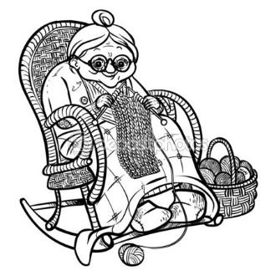
červená babička

Slide 11
Games for multicultural classes
What are they for?
6
1st group
to respect and appreciate people from different cultural background, to discover their culture and language
2nd group
to experience how the people from different cultural background might feel in a foreign country
3rd group
to realize that all human beings have something in common (needs, dreams and rights)

Slide 12
Adapting teaching materials to suit the needs of differentiated classes
Petra Vallin

Slide 13
Adapting teaching materials to suit the needs of differentiated classes
There are 2 main ways how to do it:
through Gardner‘s theory (to suit as many different intelligences as possible)
through Bloom‘s Taxonomy (to offer tasks demanding higher cognitive thinking)

Slide 14
Gardner‘s Multiple intelligence
8 different kinds of intelligence
everybody has a different mix of „intelligences“
challenging for educational system
inspiring for teachers

Slide 15
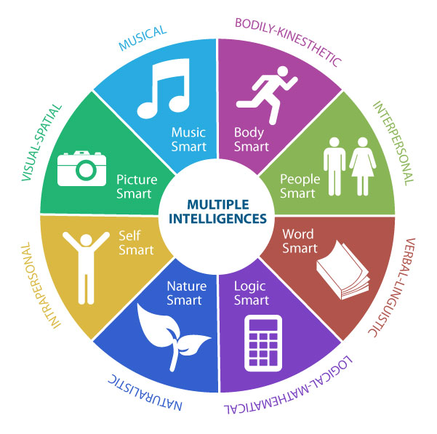

Slide 16
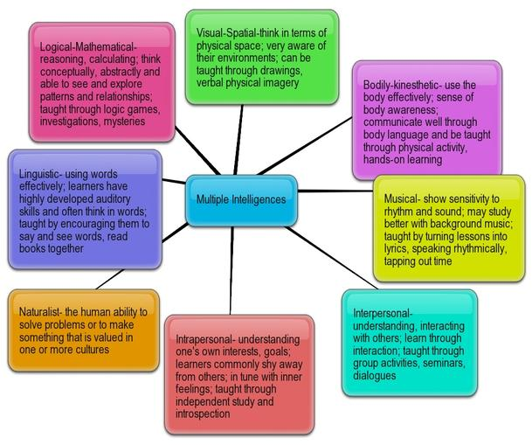

Slide 17
MULTIPLE INTELLIGENCE TEST
http://psychologytoday.tests.psychtests.com/take_test.php?idRegTest=3209

Slide 18
Task 3:
You‘re going to work in groups of 4. Imagine you are teaching the topic „Human Body“ (or any other topic) in your class. Try to think about 8 different activities according to the Gardner‘s theory of multiple intelligence.

Slide 19
What is BLOOM‘S TAXONOMY?
- a classification system used to define and distinguish different levels of human cognitive skills (i.e., thinking, learning, and understanding etc.)
- used to inform or guide the development of assessments (tests and other evaluations of student learning), curriculum (units, lessons, projects, and other learning activities), and instructional methods such as questioning strategies
- published in 1956 by a group of American psychologists (Benjamin Bloom), revised in 2001 by Anderson a Kratwohl
- created in order to promote higher forms of thinking in education (education in general promotes lower forms of thinking such as remembering)

Slide 21
Petra Vallin
Faculty of Education
Charles University in Prague
petra.koukalova@pedf.cuni.cz

