Slide 1
Welcome to our school! ☺

Slide 2
Základní škola a Mateřská škola Červený vrch
http://www.zscvrch.cz/

Slide 3
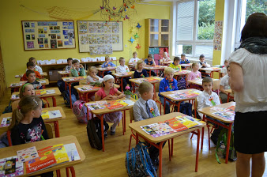
Basic Information
ZŠ a MŠ Červený vrch (= elementary school + nursery)
Prague 6, Červený vrch (near metro station Nádraží Veleslavín)
52 years old school
Number of pupils: 763
Age: 6 – 11 years old (1st grade)
+ 11 – 15 years old (2nd grade)
Number of classes: 31
Number of teachers: 52
(with one English native speaker)
Number of classrooms: 38

Slide 4
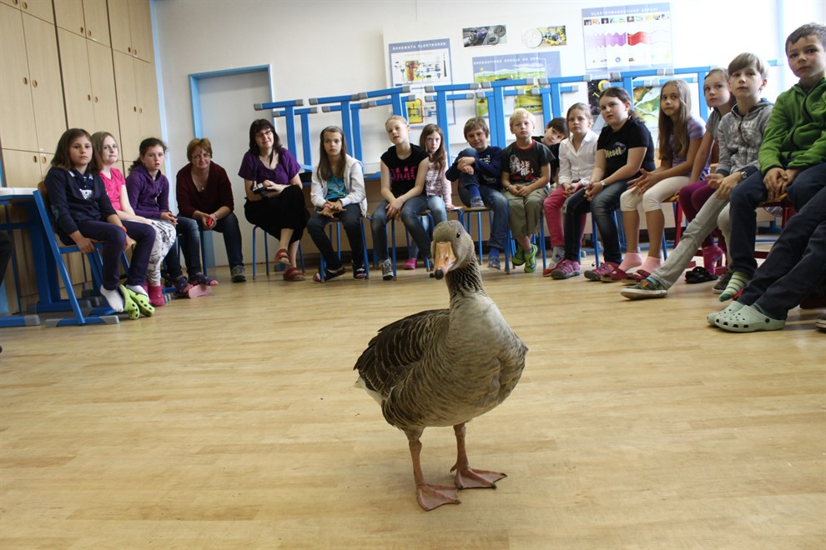
Subjects
We learn…
Our favourite subjects are…
We don´t like….
The most boring x
the most interesting subject is…
Our favourite teachers are…

Slide 5
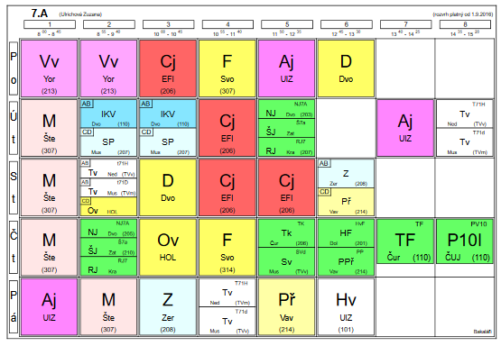
Typical school day
School starts at 8 a.m. and finishes at different times (around 1 or 2 p.m. or after afternoon lessons)
Each lesson is 45 min long and is started and finished by ringing a bell.
And then, we have 10 min long breaks and one 20 min long break in the middle of the day
There is a possibility to have lunch in our school cantine.

Slide 6
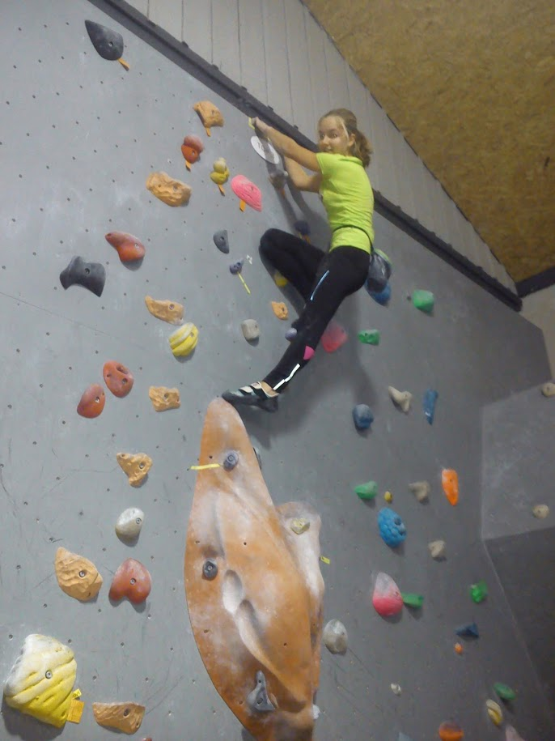
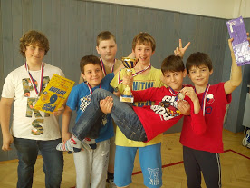
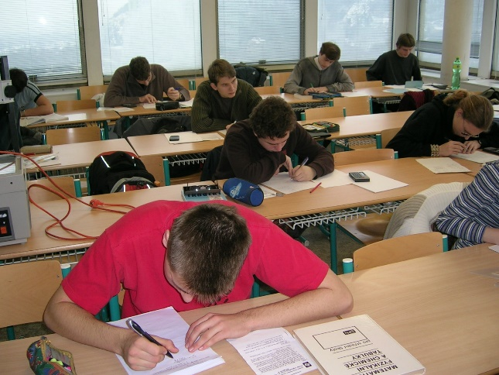
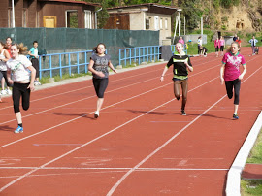
Competitions
We are really clever, intelligent and
competitive pupils and so we take
part in lots of competitions:
Maths competitions
English competitions
Competitions in Czech language
Biology Olympiad
Science and Physics competitions
Geography Olympiad
ICT competitions
Sports competitions

Slide 7
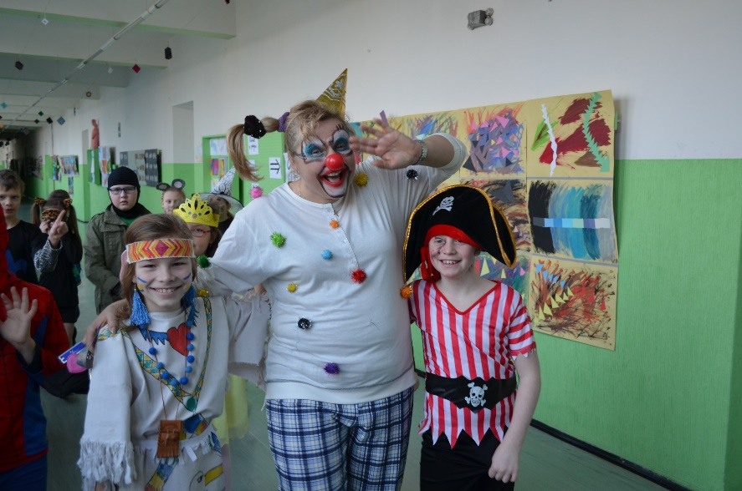
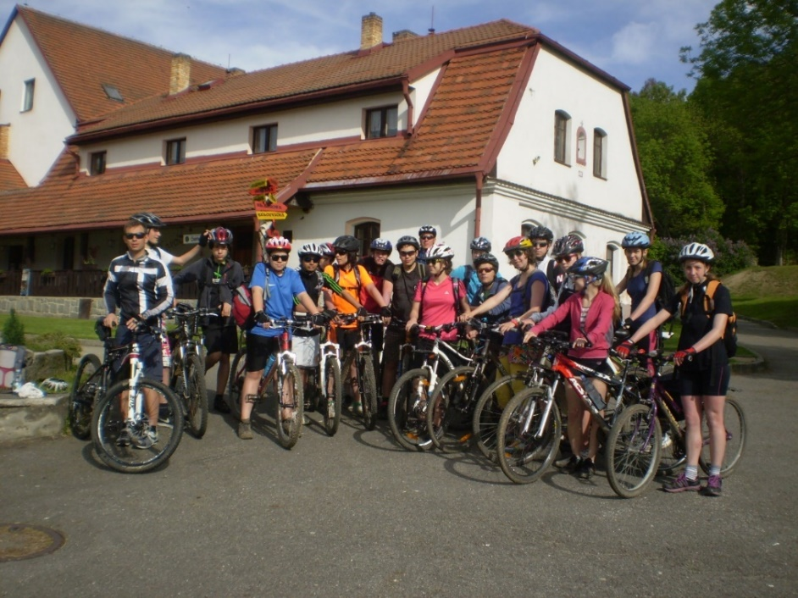
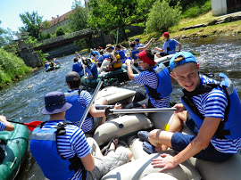
Activities
Teambuilding week
School trips
Going to theatres, cinemas
Excursions (to a bank, to an observatory,
to a library, to Osvětim, etc.)
Christmas fair and concert for parents
Skiing course
Masopust Carnival
Outdoor school week
Cycling course
Canoeing course
School celebration
Week in England (London), visiting Dresden
Sports day

Slide 8
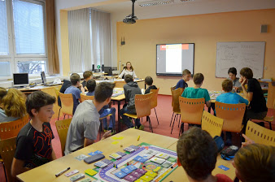
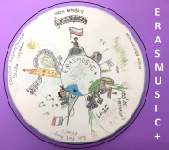
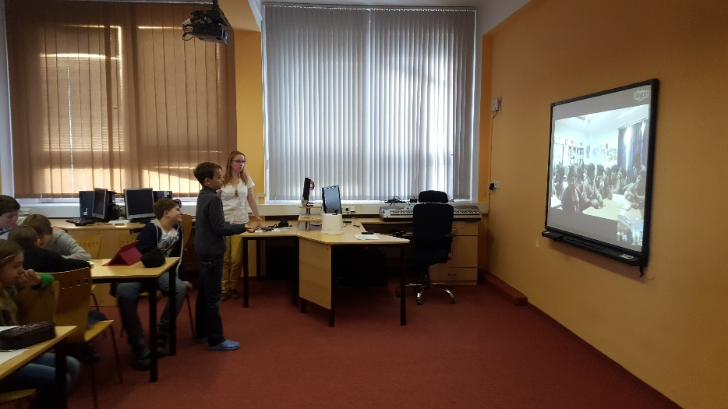
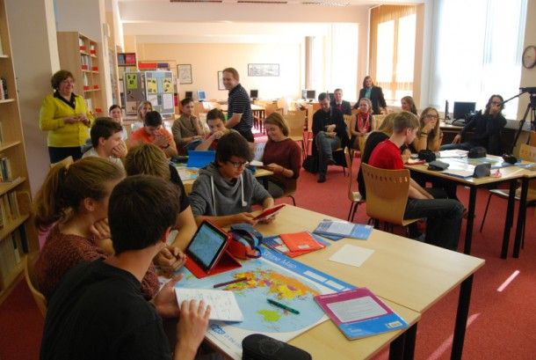
Projects
in our school:
Night with Andersen
First Aid Course
Online Safety
Financial literacy
international:
Erasmusic+
Skype in the classroom
Letter Exchange

Slide 9
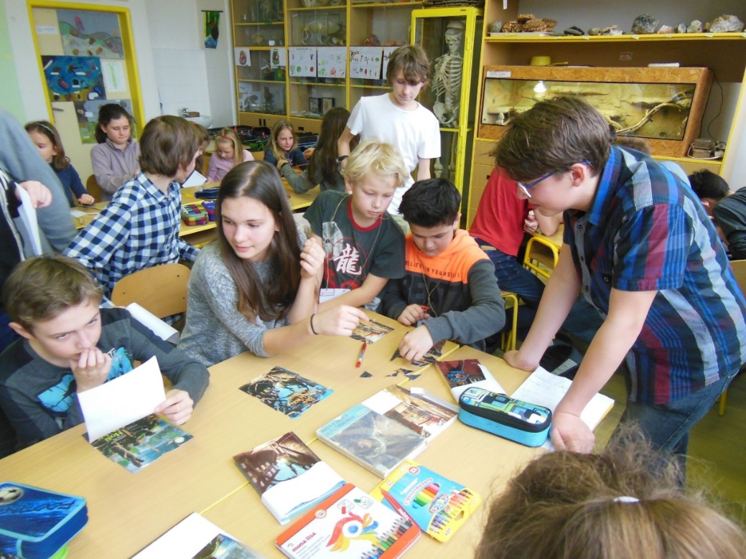
School Project Days
Once a year we have special project days for the whole school.
That means that older children prepare activities and programme for younger kids and then both these classes spend one day together and realize the project activities.
TOPICS:
2016/2017 Josef Lada, Josef Čapek, Jaroslav Foglar
(anniversary of their birthdays)
2015/2016 Charles IV.
2014/2015 Celebration of 50 years of our school
Etc.

Slide 10
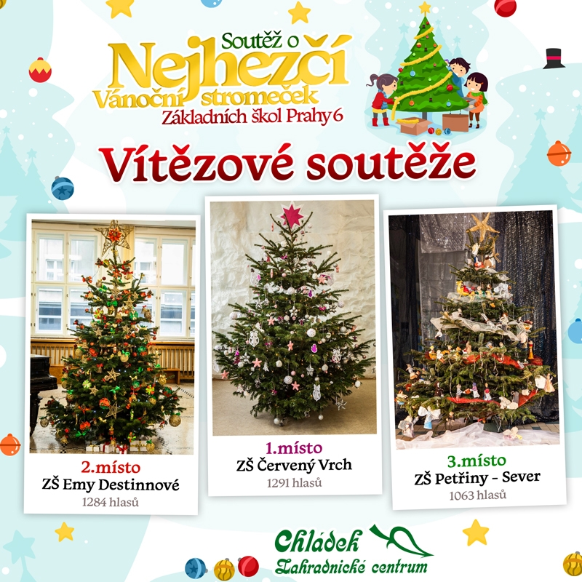
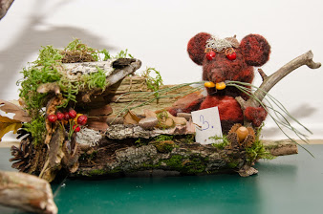
Holidays
Autumn Holiday (at the end of October)
Christmas Holiday
Spring Holiday (in February/March)
Easter Holiday (in April)
Summer Holidays (July + August)

Slide 11
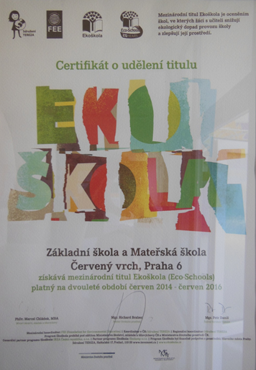
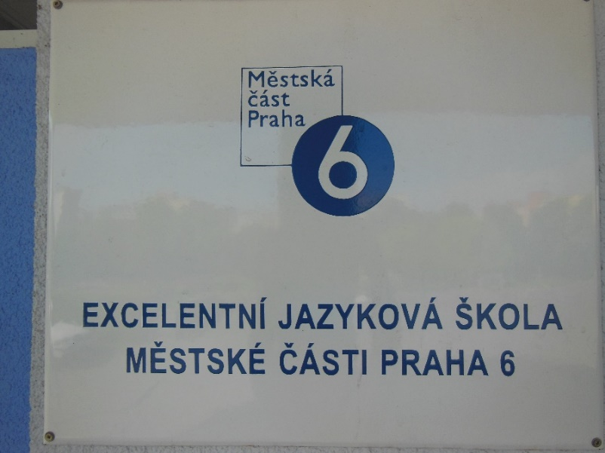
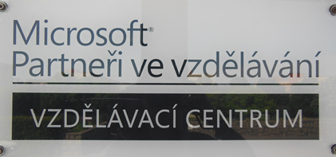
Awards
Excellent language school
Eco - Schools
Educational centre of Microsoft
Etc.

Slide 12
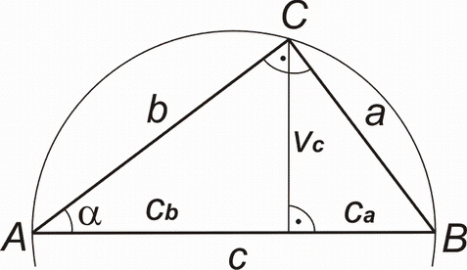
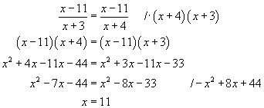
Maths classes
Entrance exams
6th – 9th year
more Maths lessons
more Physics, Chemistry, Science
one lesson with the English native speaker + extra subject Maths in English
These students have amazing results in competitions and tests for comparing of schools,
and of course, in their future career

Slide 13
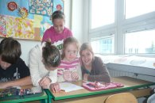
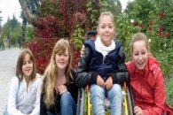
Children with handicaps
Our school is open to children with handicaps.
It is without barriers that means that education in this school can be given also to pupils with some kind of handicap.
Pupils with wheelchairs, blind kids, children with illnesses (diabetes,…), Down Syndrom,…
Help: a lift, a classroom and a toilet without a doorsill, access to school without stairs (wheelchair ramp), an assistent in the class, special diet in the school cantine, a possibility to use a computer in lessons,…
Cooperation: parents, a school psychologist,
a special educator, a school counsellor, a school
counseling centre

Slide 14
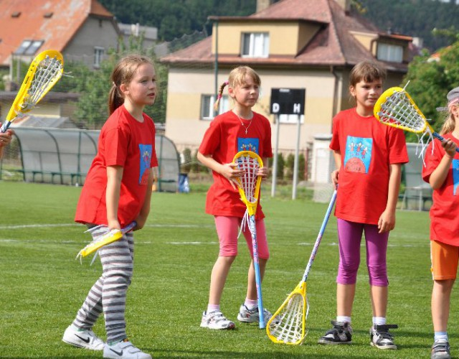
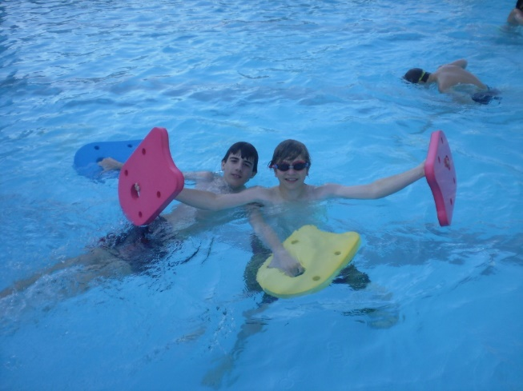
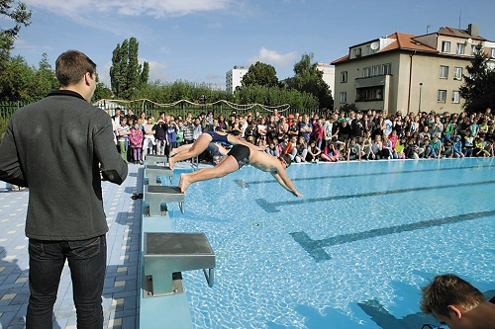
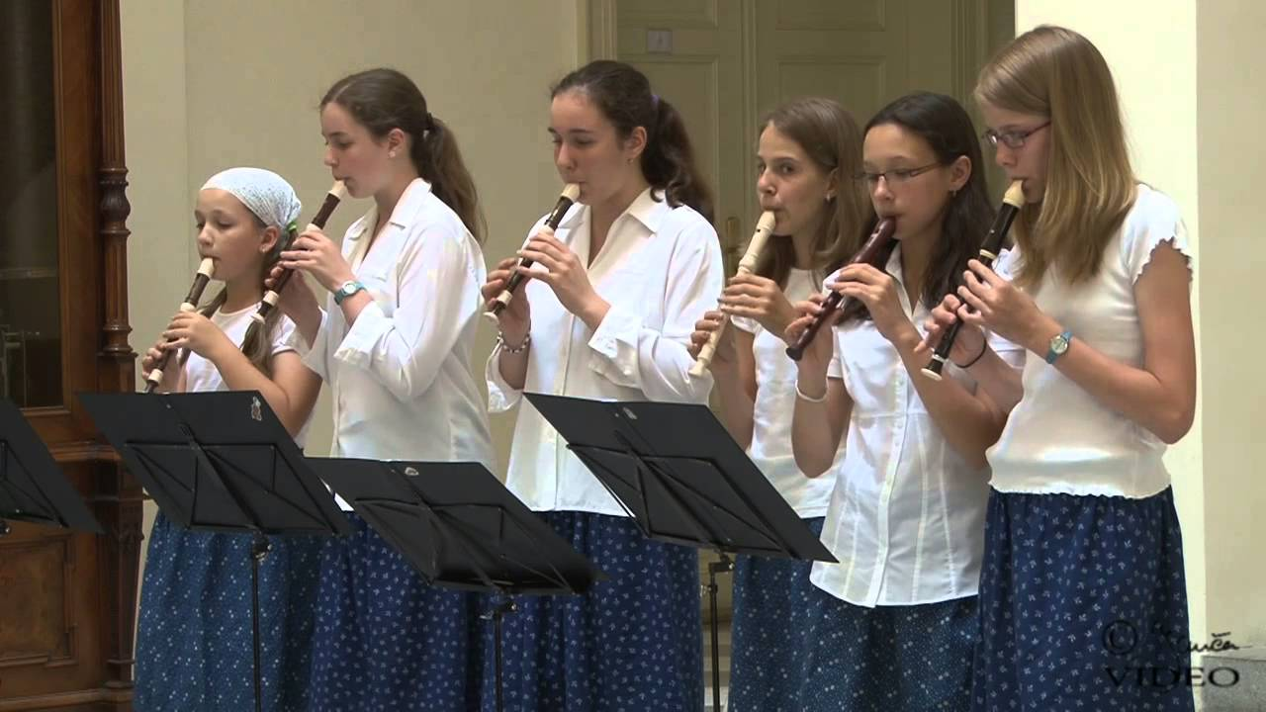
Free time activities
Aerobic
Swimming training
Floorball
Flute
Lacrosse
English classes
Chess
Pottery, Etc.

Slide 15
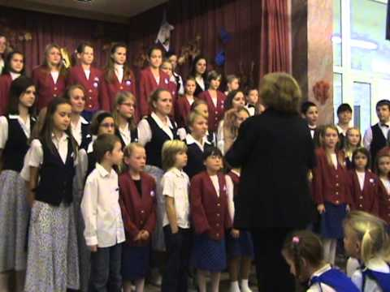
School choir
Sedmihlásek
Concerts, performances, competitions
Long history
Nowadays, it has less members than it used to have.
They have been on TV
They have travelled to many countries (Germany,
Poland, France, Norway, Austria, Italy, Russia, Latvia,…)
https://www.youtube.com/watch?v=W7s8ETGW0F4

Slide 16
Presentation created by Mgr. Veronika Rabiňáková ©

