Slide 1
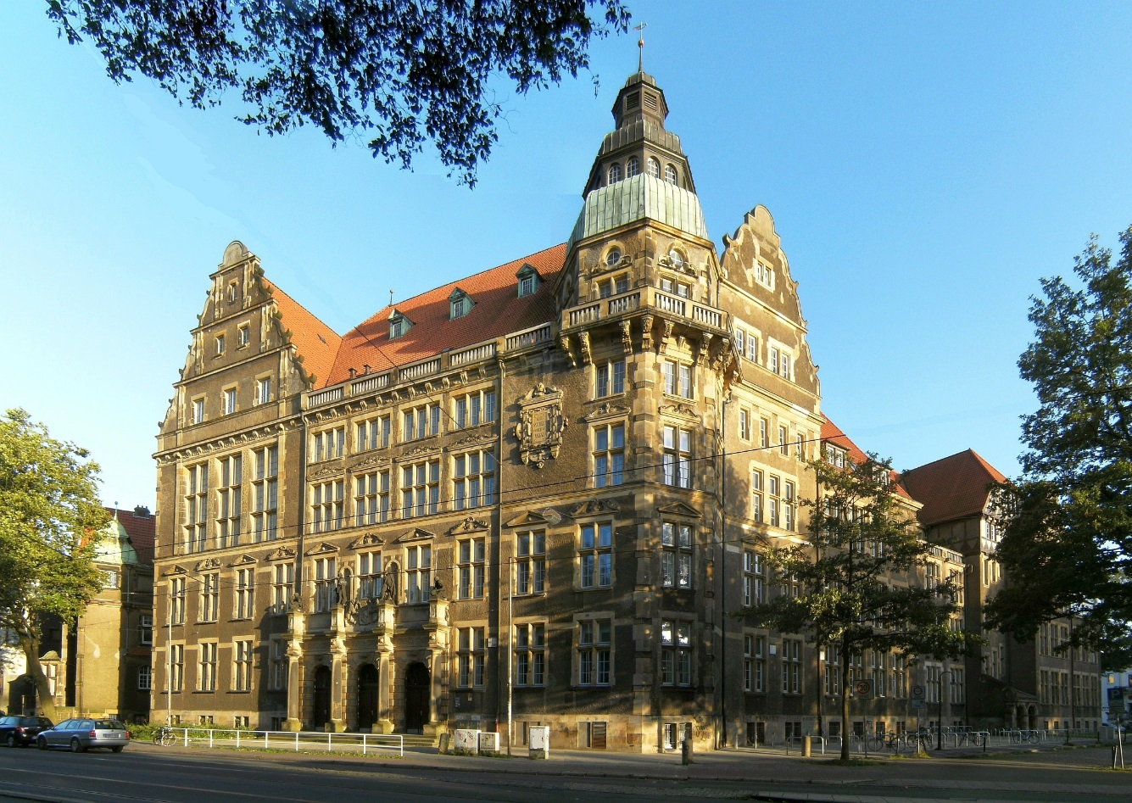
Hermann-Böse-Gymnasium
Willkommen!
Welcome!
Bienvenu!
Benvenuto
Bienvenidos!
Boa Vinda!
Ni Hao!

Slide 2
Origin of the name
Hermann Böse, 1870 – 1943
Music teacher from 1907 – 1943
Composer and leader of the choir
KPD top candidate 1919
Leader of the „Volkskommissariats
für Schul- und Bildungswesen“
Concentration Camp detainee

Slide 3
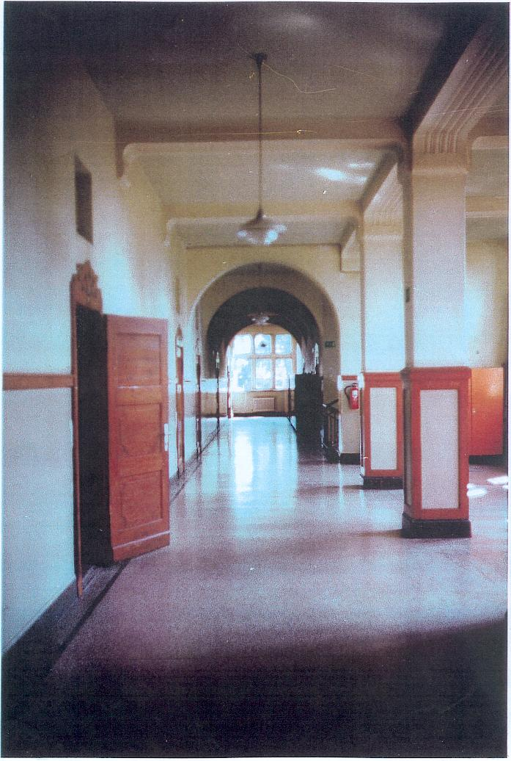
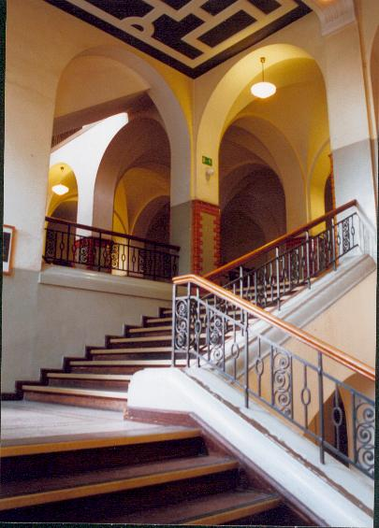

Slide 4
Projects
Bundeswettbewerb Jugend forscht
Soziales Lernen – Lions Quest
Comenius
Model European Parliament
Model United Nations
Bundeswettbewerb Jugend debattiert
Chess
Jugend trainiert für Olympia
Basketball
School band
Musical Week
Bundeswettbewerb Fremdsprachen
Annual Project Week

Slide 5
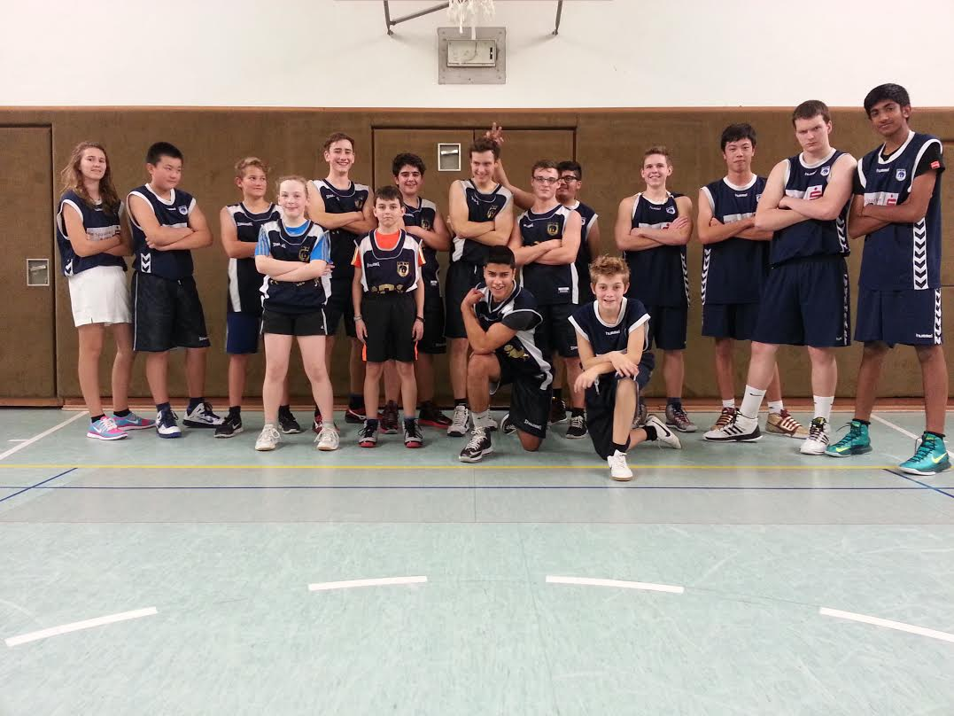
Sport at the HBG

Slide 6
Comenius
Culture and Science

Slide 7
Comenius
Culture and Science

Slide 8
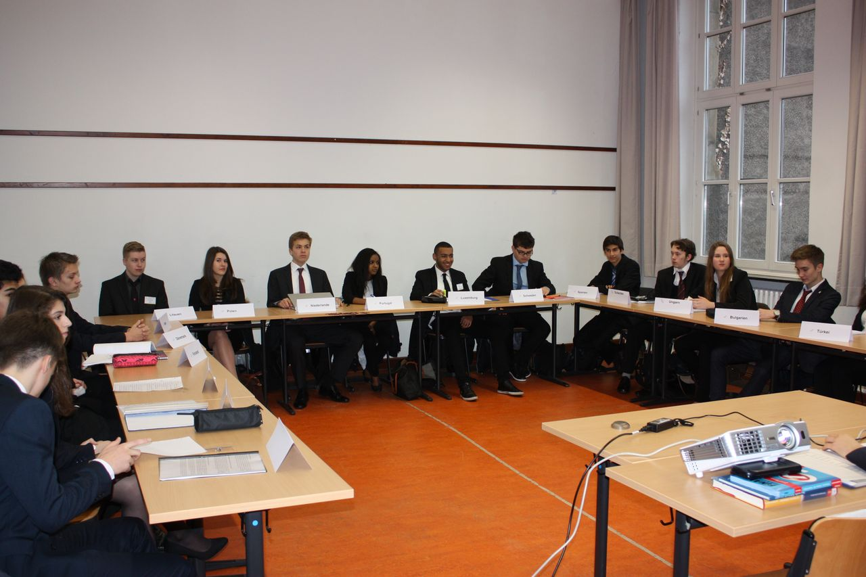
Model European Parliament

Slide 9
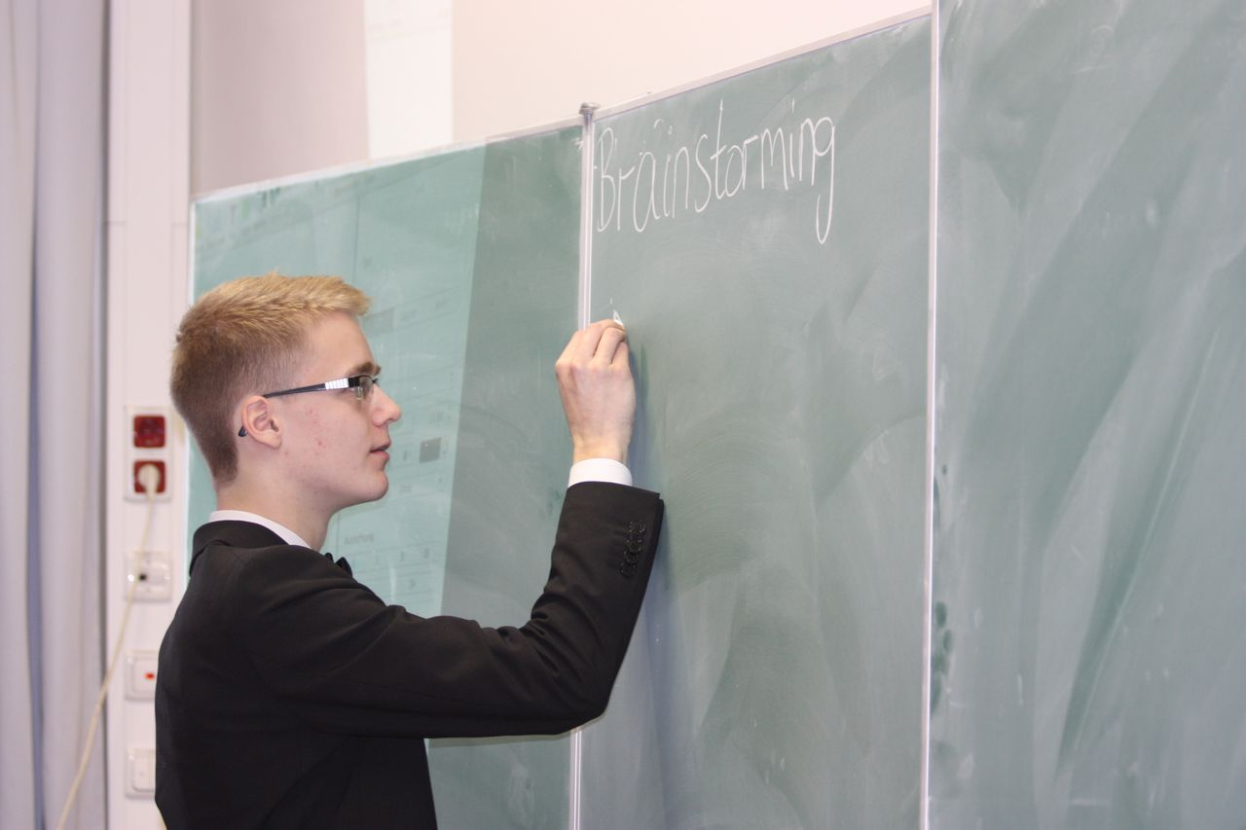
Model European Parliament

Slide 10
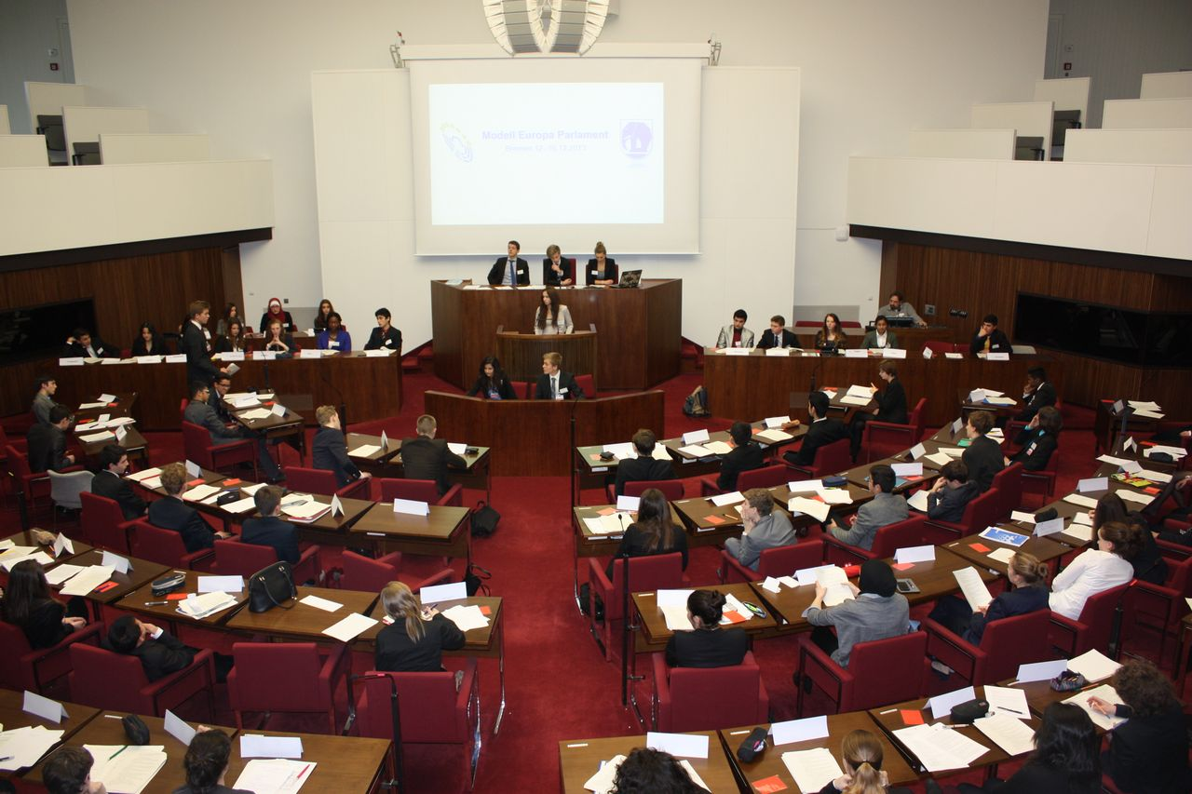
Model European Parliament

Slide 11
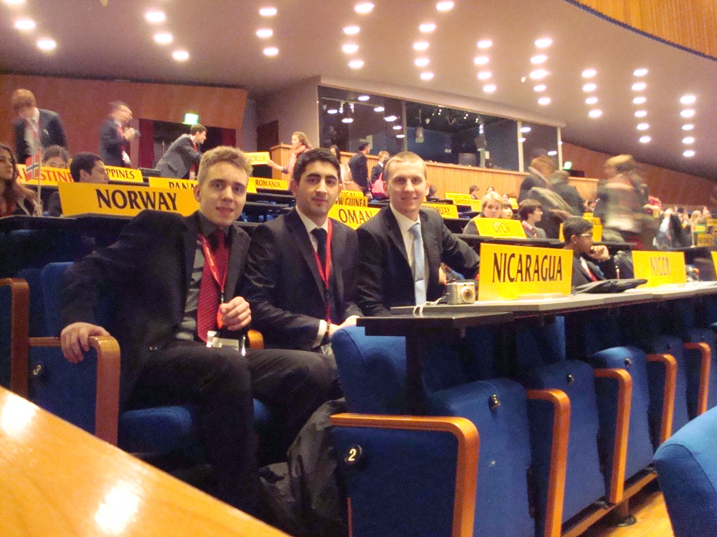
Model United Nations

Slide 12
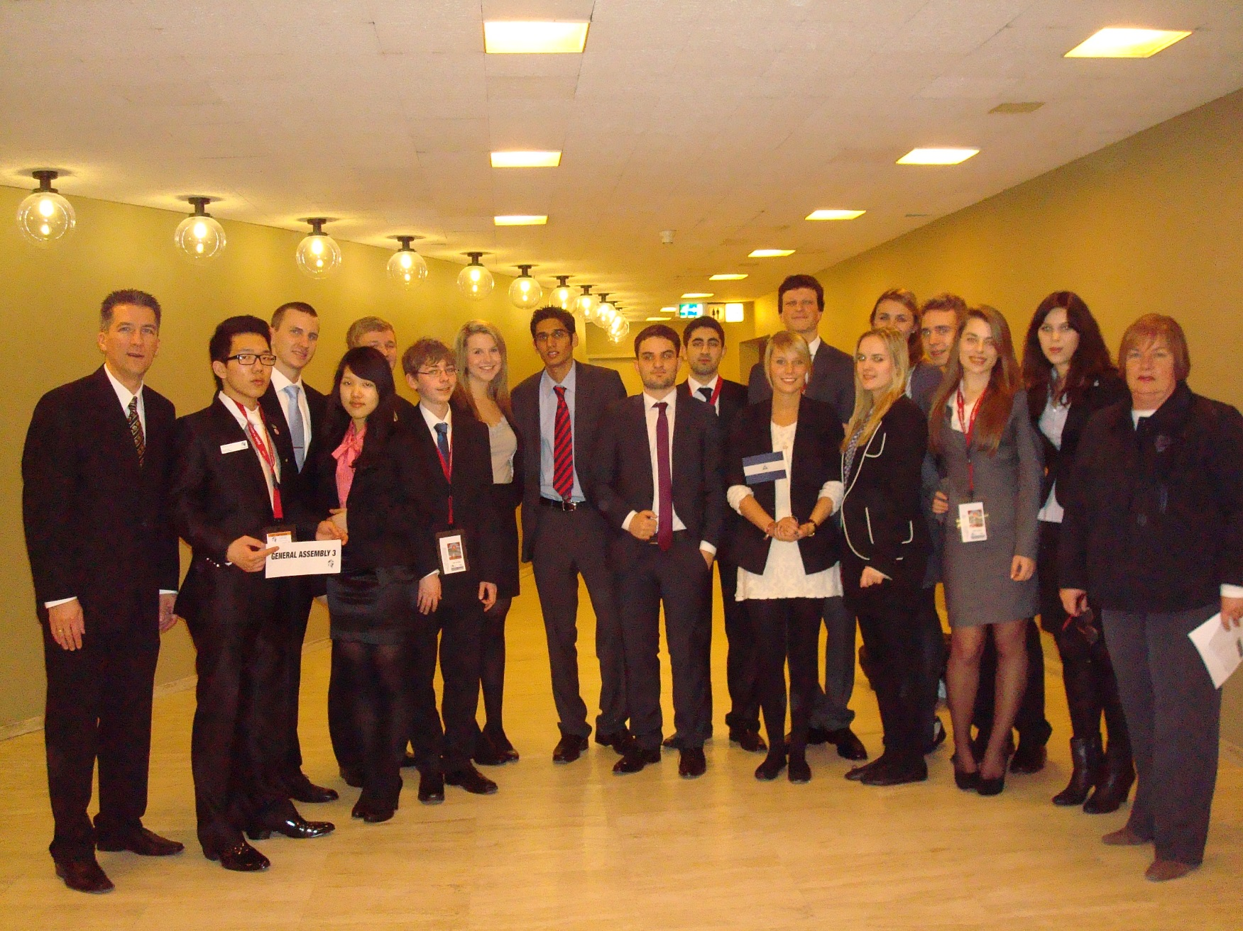
Model United Nations

Slide 13
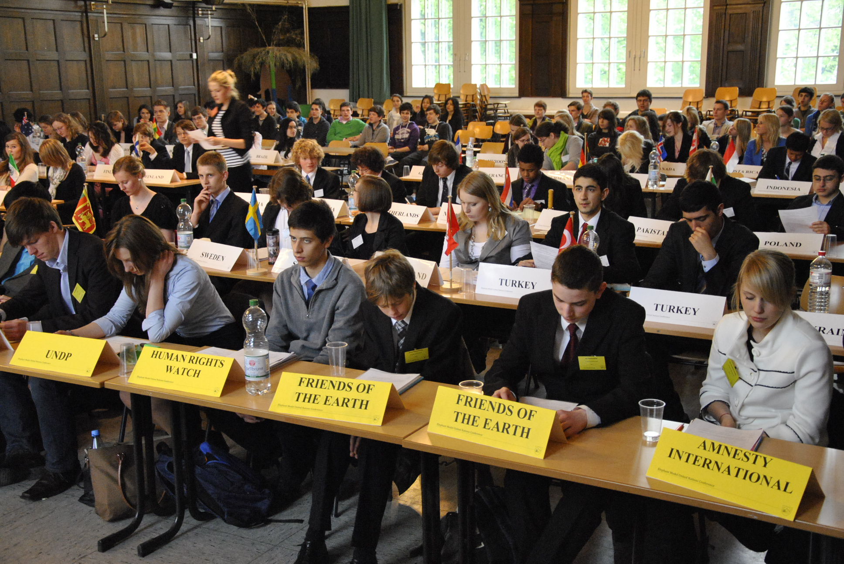
ELMUN

Slide 14
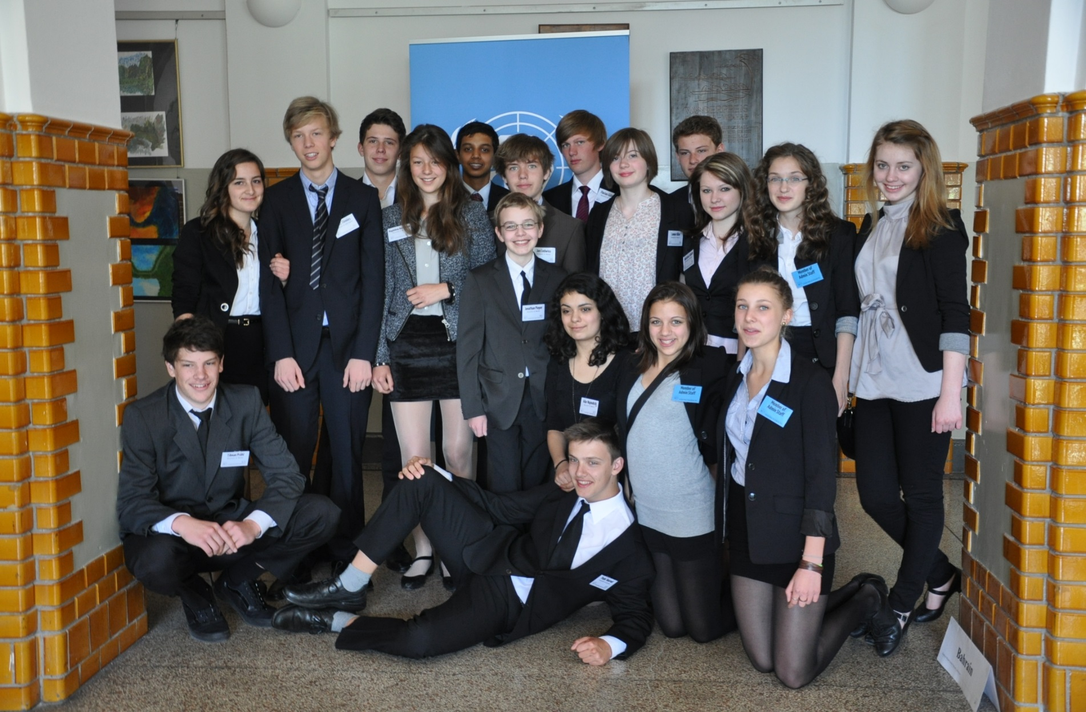
ELMUN

Slide 15
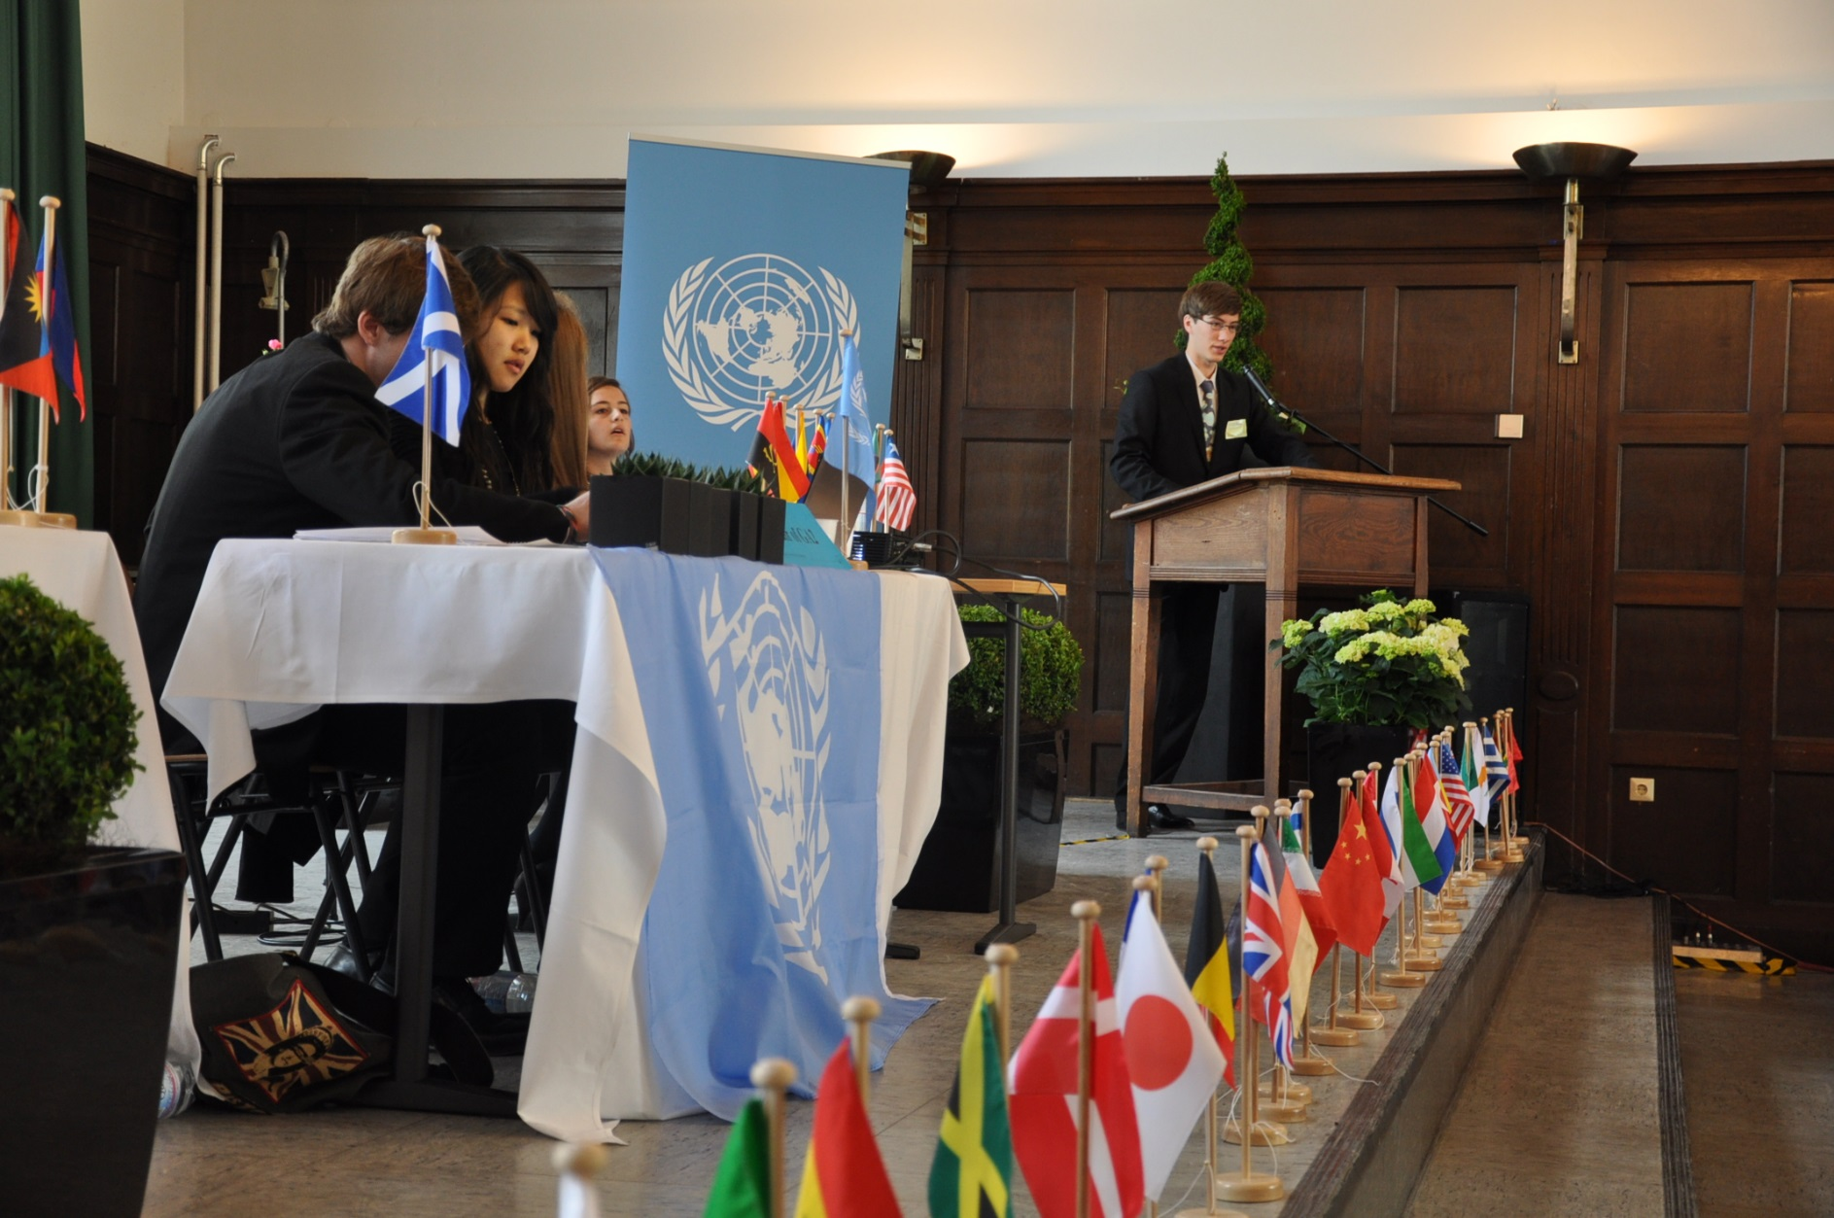
ELMUN

Slide 16
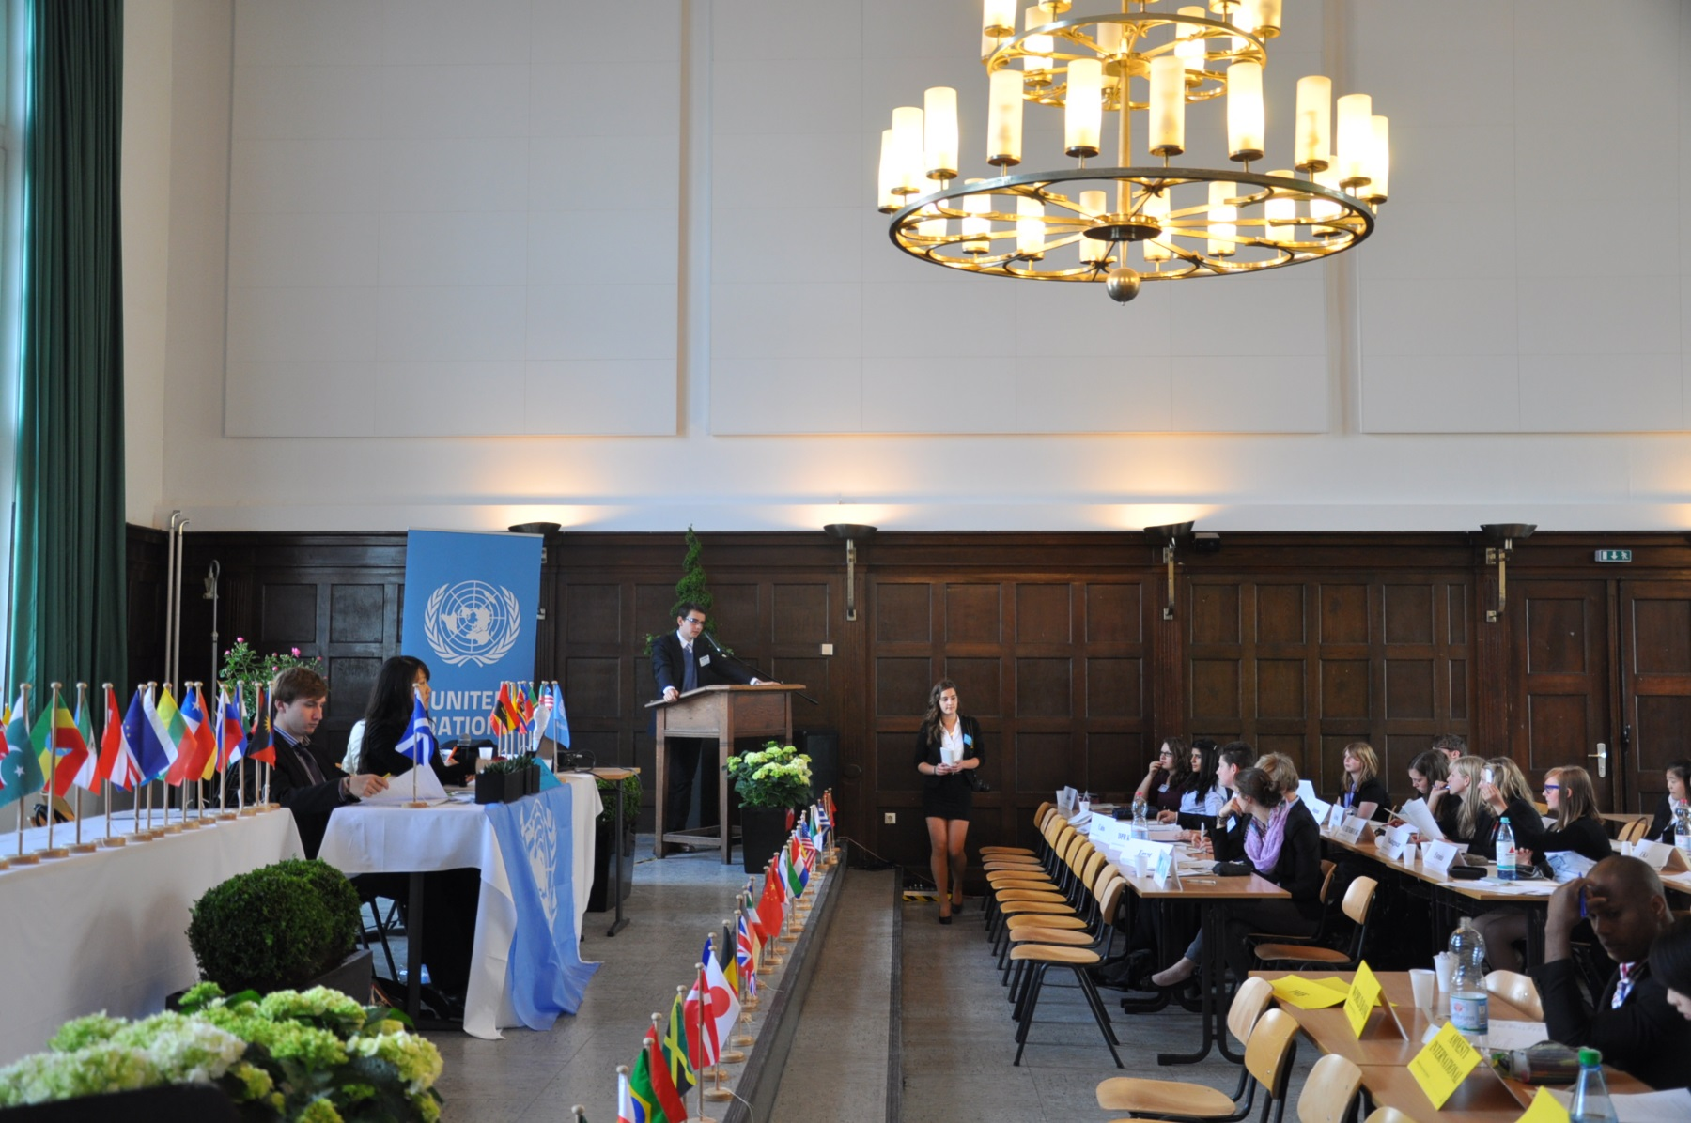
ELMUN

Slide 17
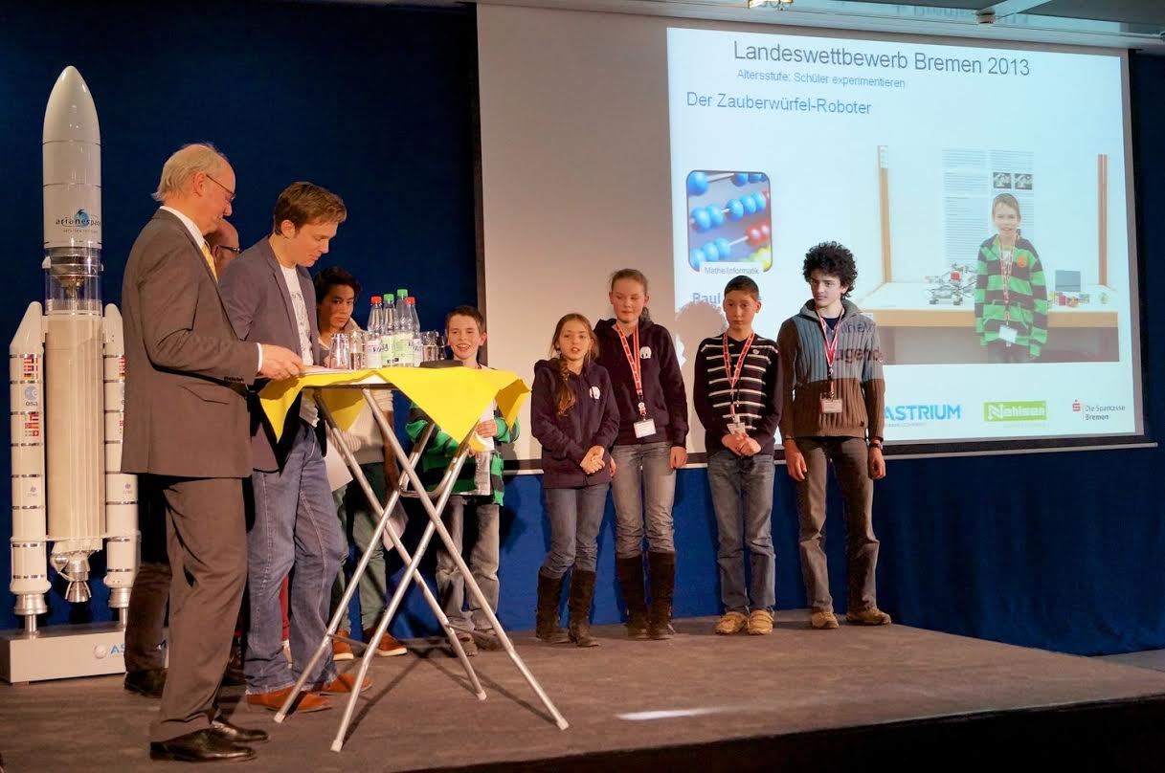

Slide 18
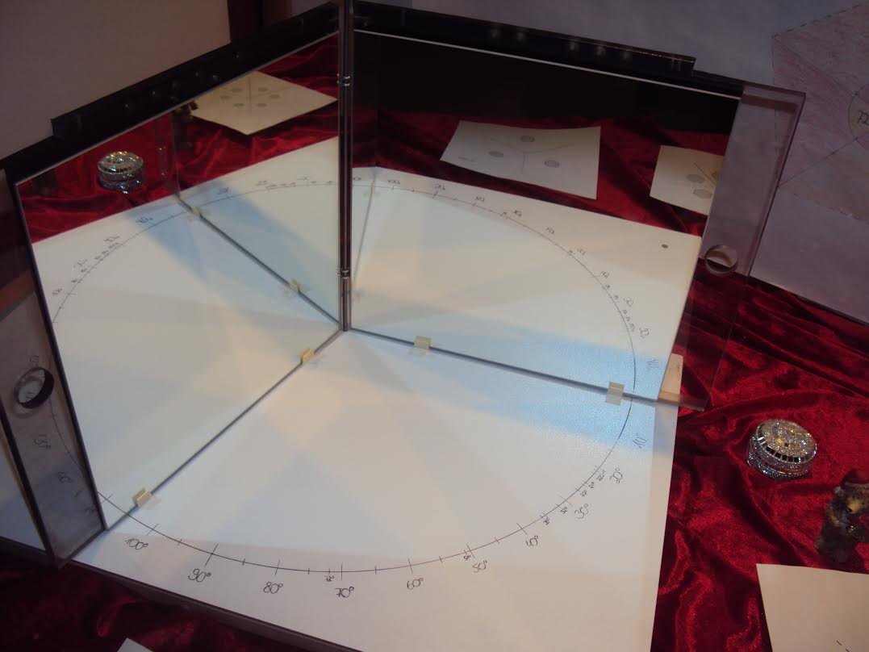

Slide 19
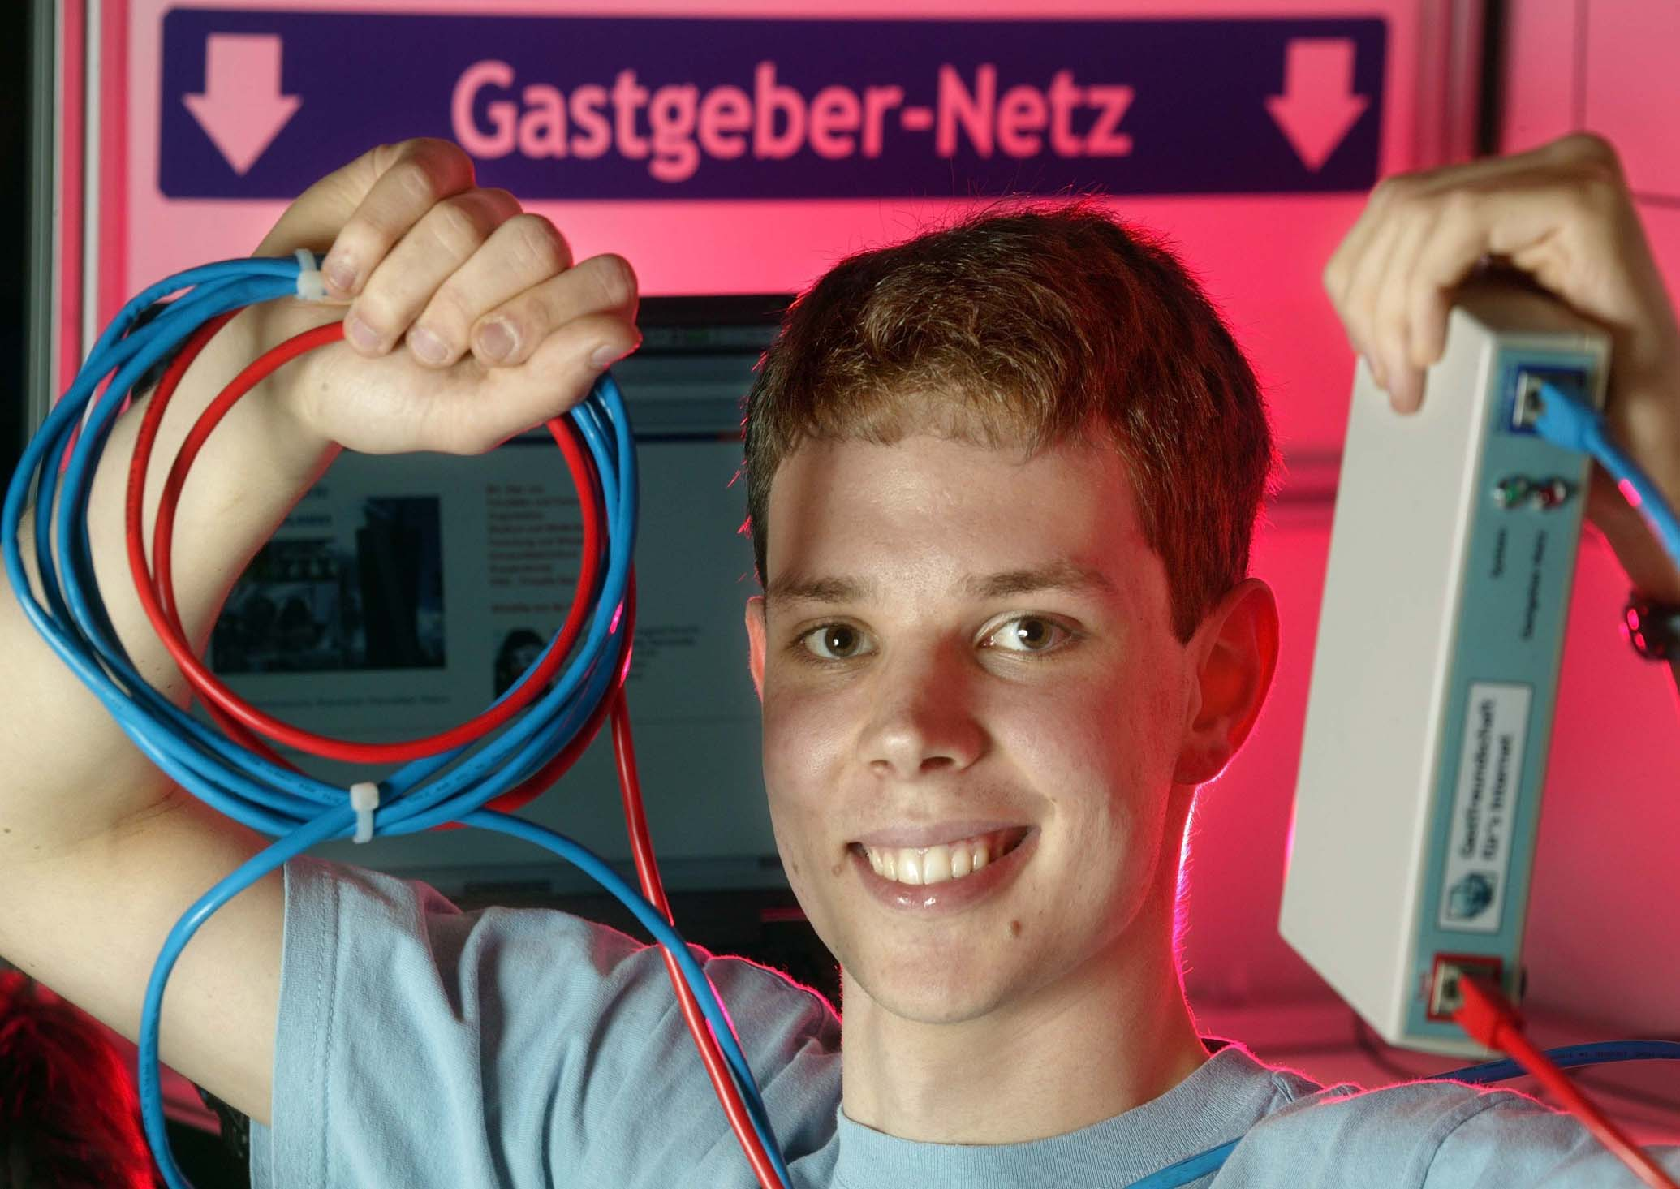

Slide 20
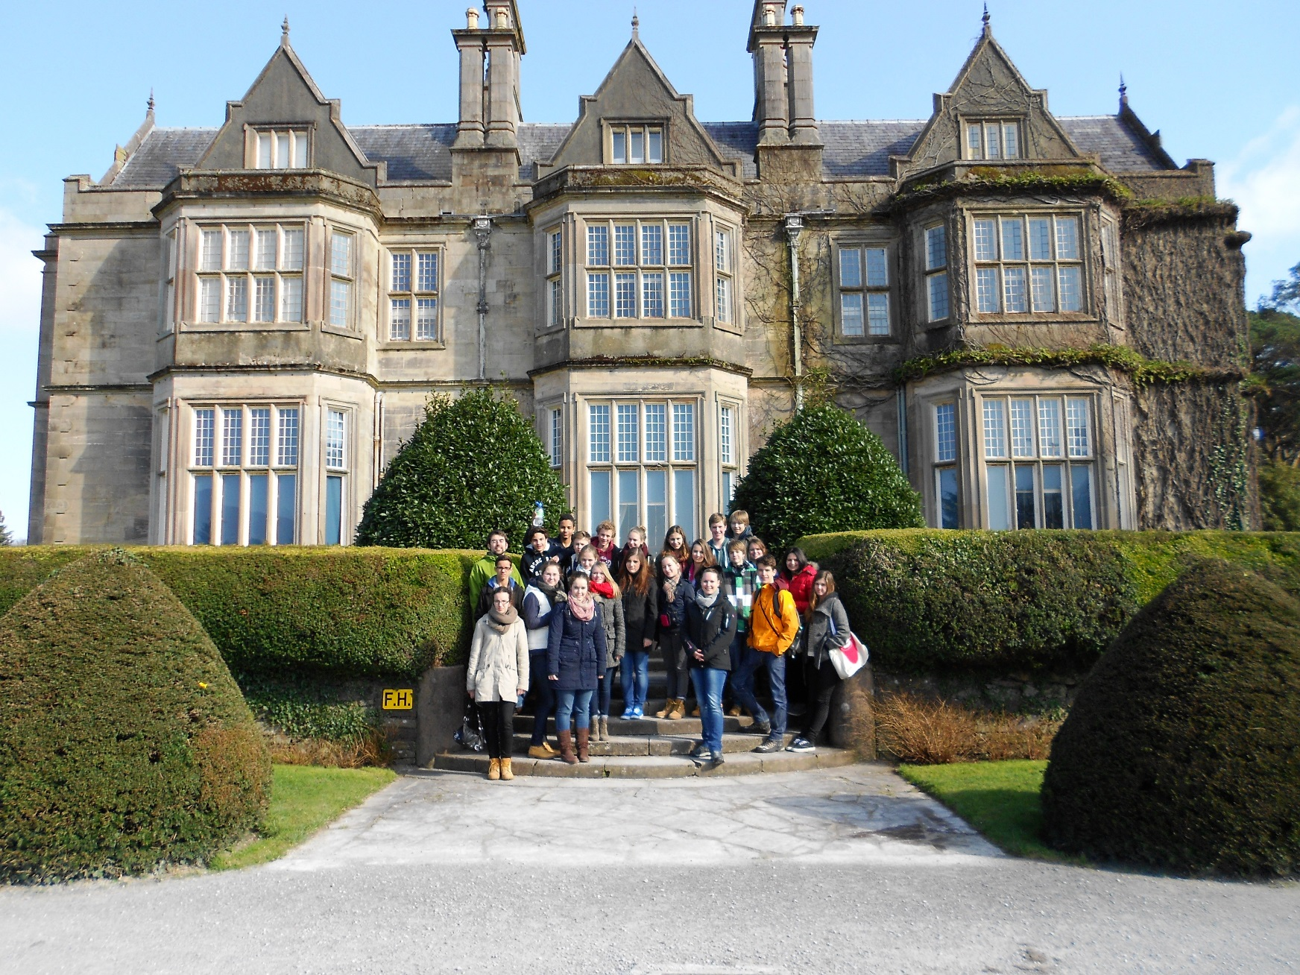
Partnerschool in Cork, Irland

Slide 21
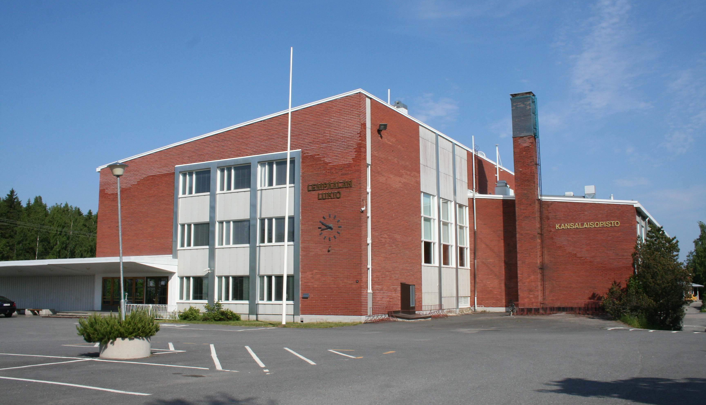
Partnerschool in Lempäälä, Finland

Slide 22
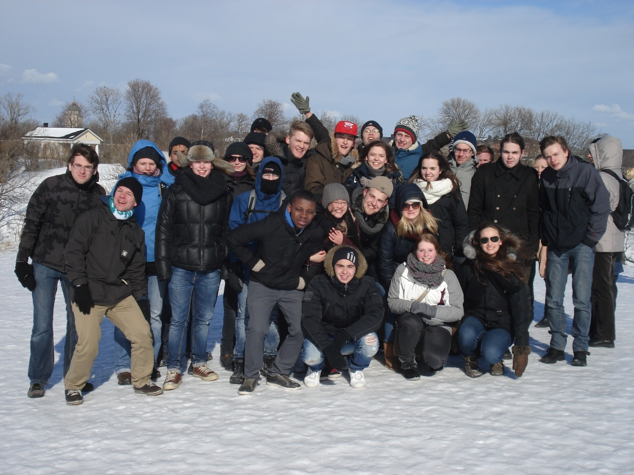
Partnerschool in Lempäälä, Finland

Slide 23
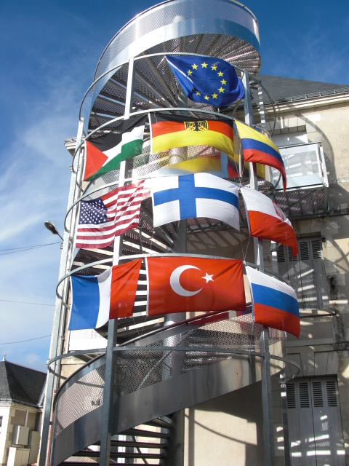
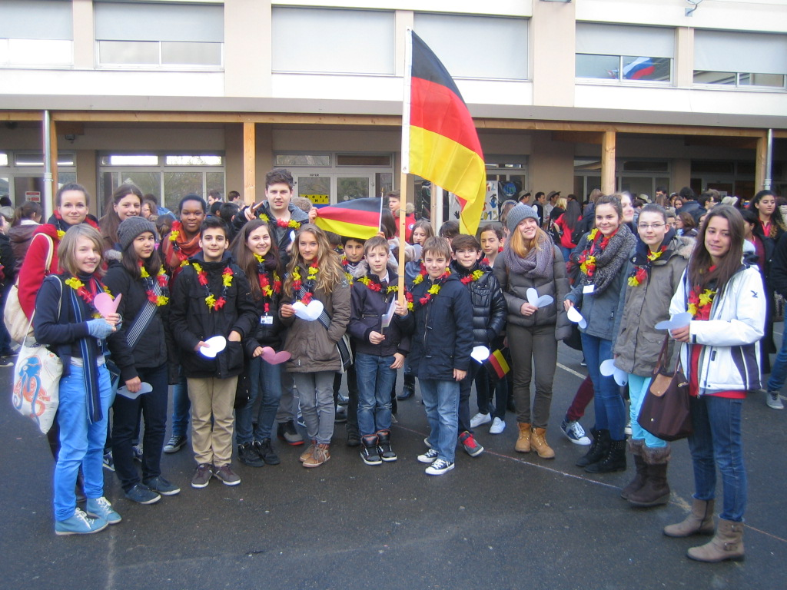
France Exchange

Slide 24
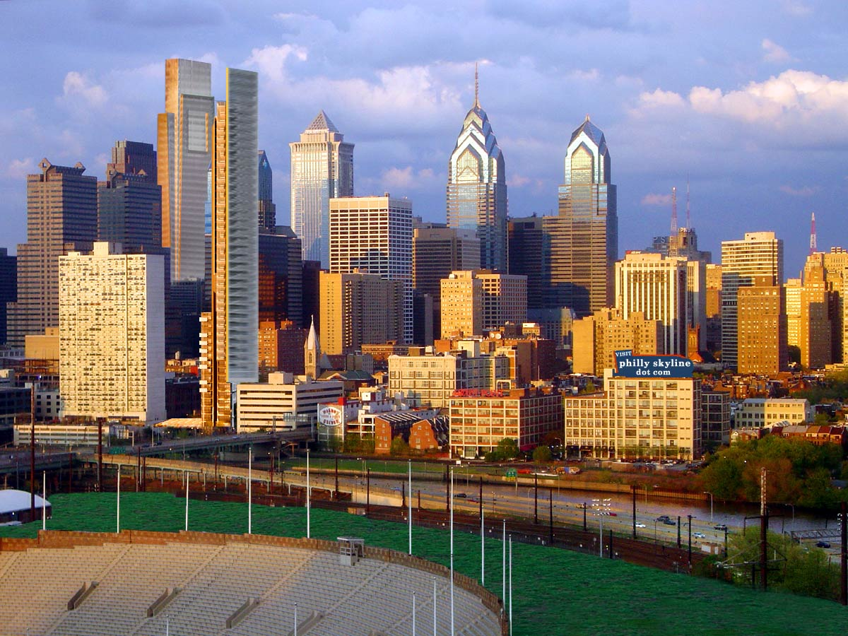
Philadelphia Exchange

Slide 25
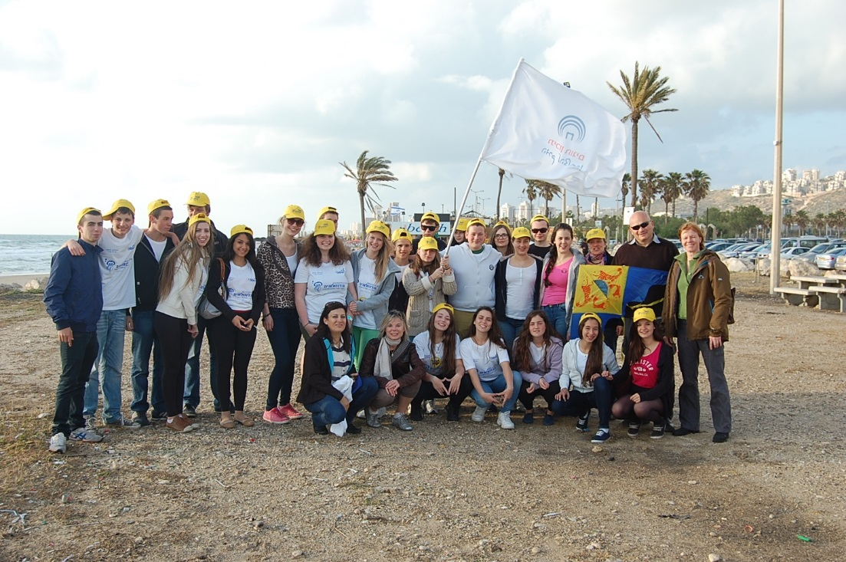
Israel Exchange

Slide 26
Christmas Market

Slide 27
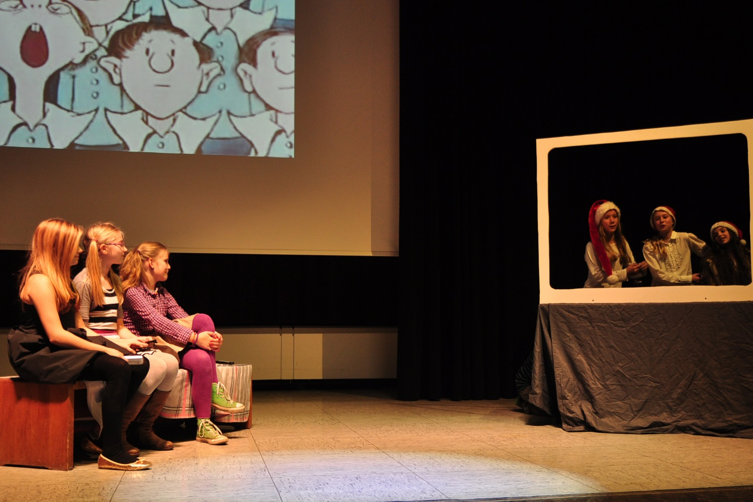
Christmas Market

Slide 28
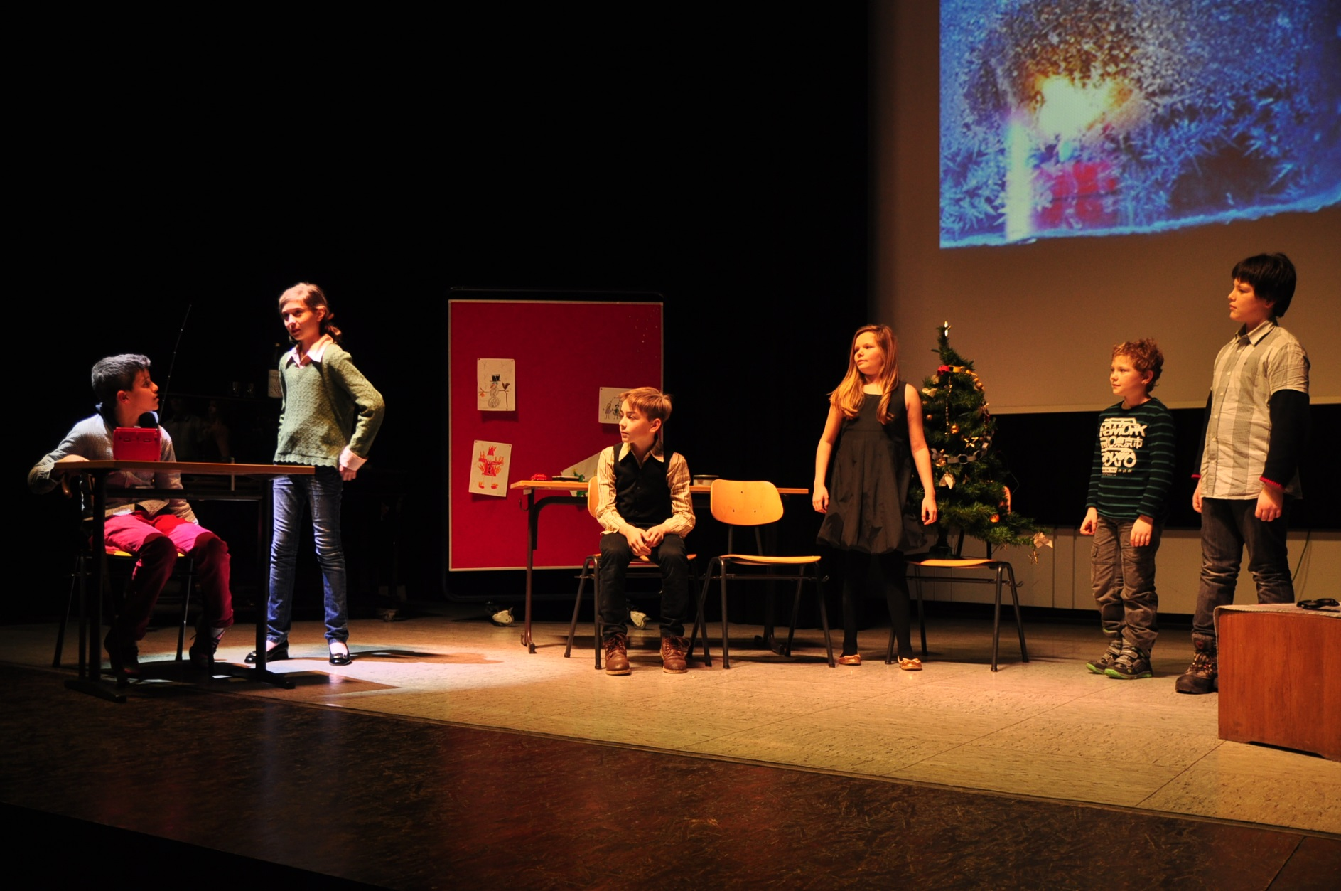
Christmas Market

Slide 29
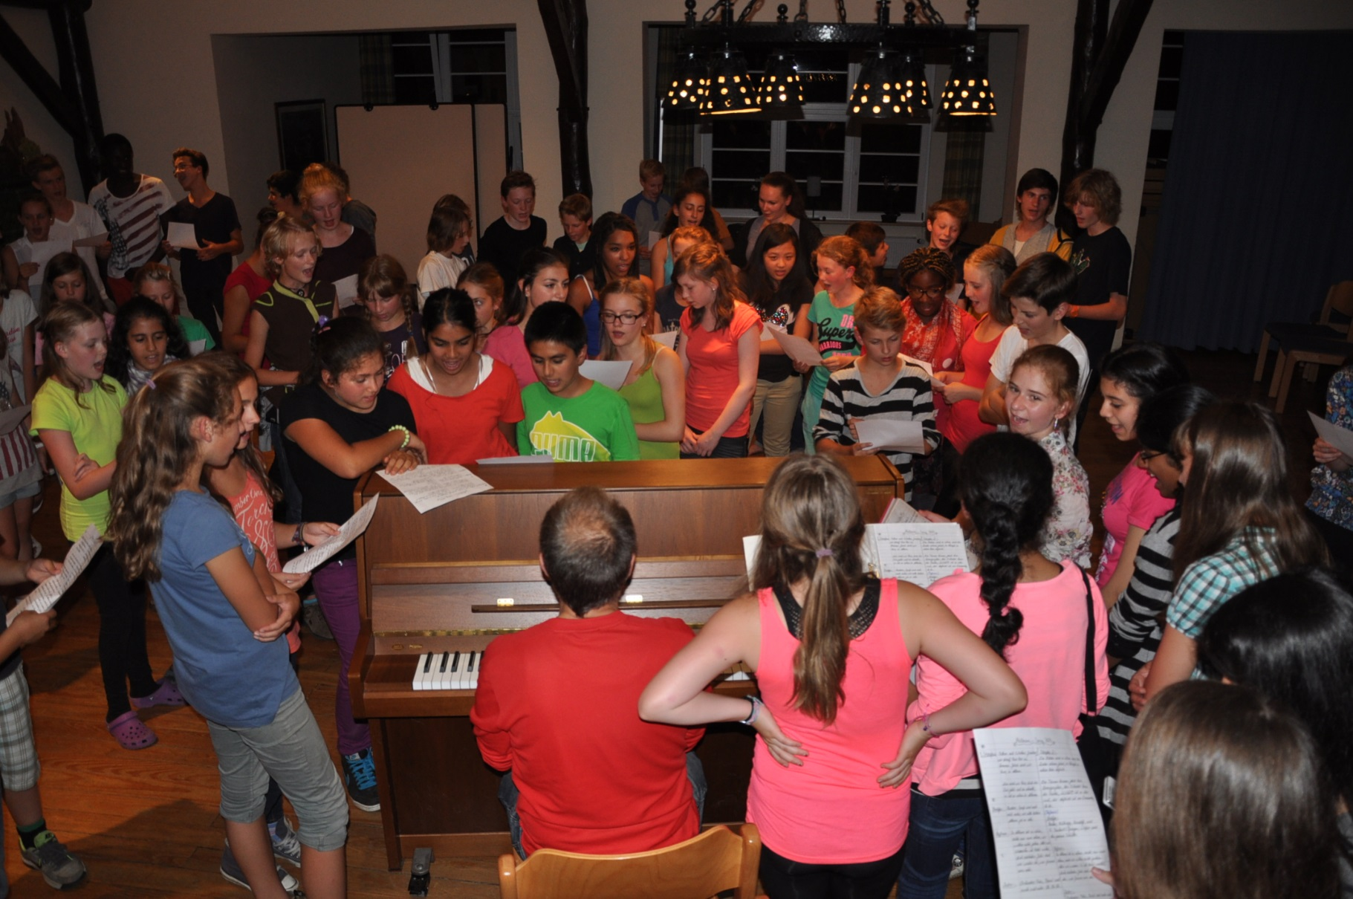
Musical Week in Ahlhorn

Slide 30
Musical Week in Ahlhorn

Slide 31
International Youth Scientific Congress, Madrid

Slide 32
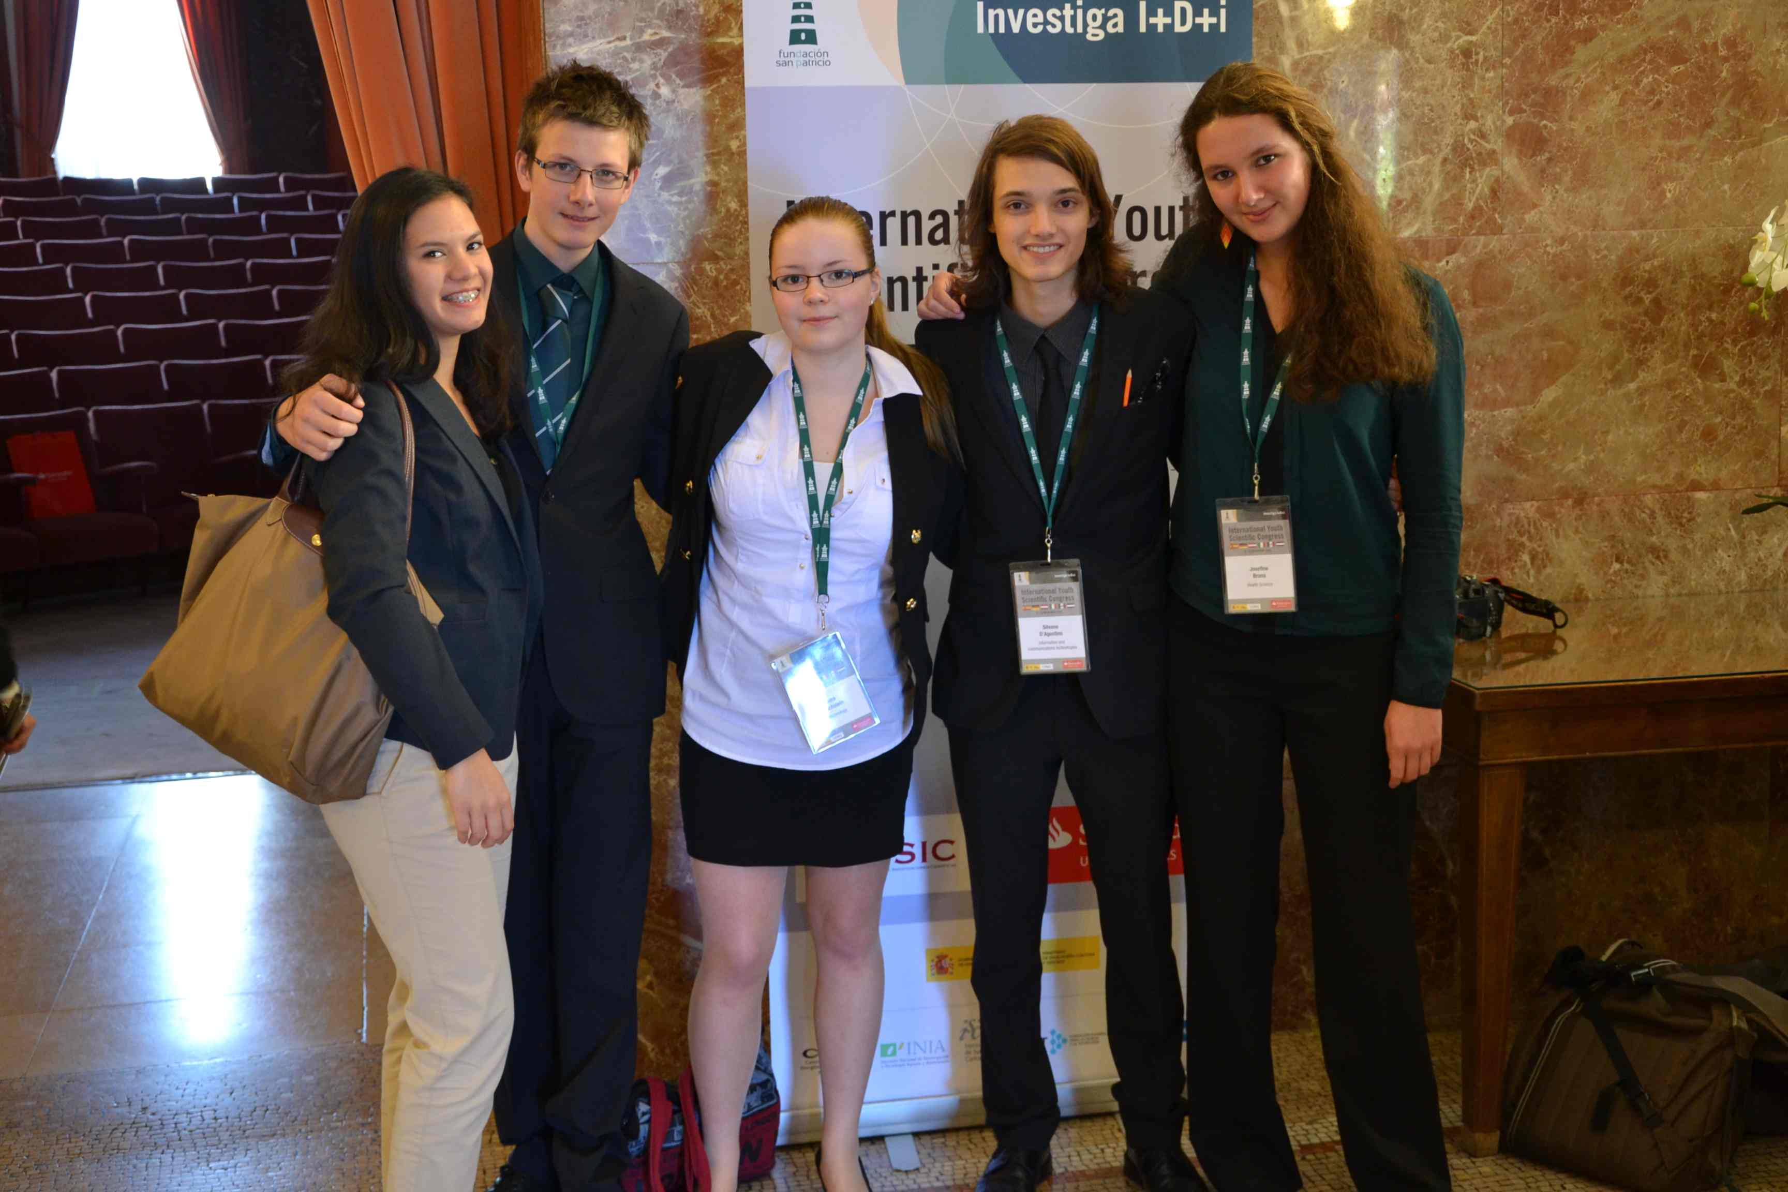
International Youth Scientific Congress, Madrid

Slide 33
