Slide 1
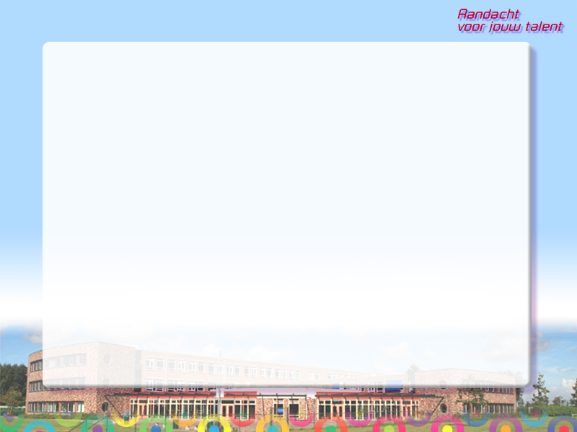

Welcome
at
PENTA college CSG
Jacob van Liesveldt

Slide 2
Penta college: seven schools
Region of Voorne-Putten
Open (Protestant) Christian identity
± 1500 students (12-18 years)
± 140 teachers & staff
3 levels: mavo – havo – vwo

Slide 3
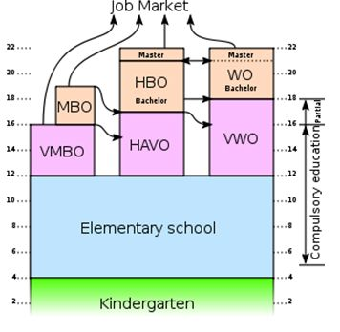
The Dutch educational system
Senior
Vocational
University
Vocational
Pre-university
Pre-vocational
(including mavo)
General
secondary

Slide 4


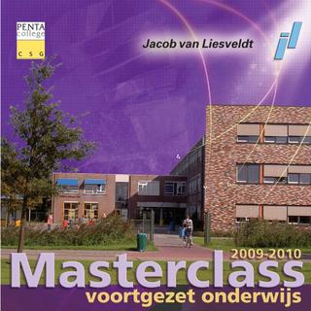


Jacob van Liesveldt

Slide 5

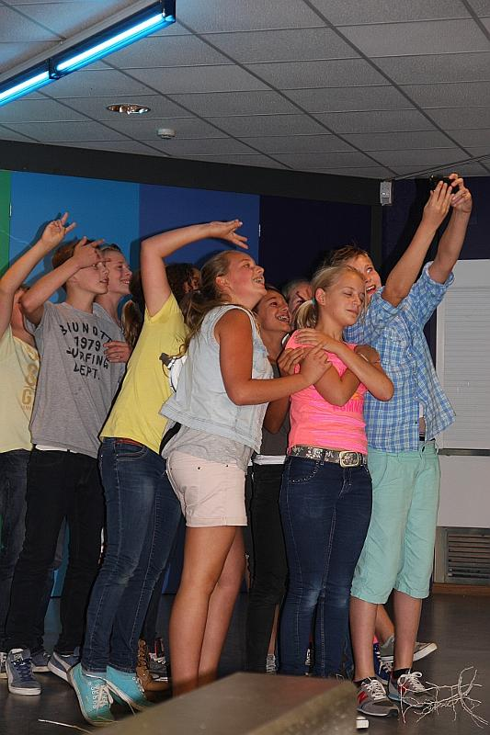
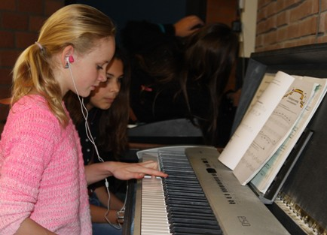
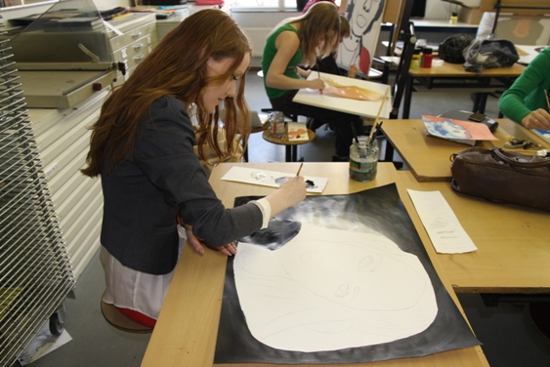
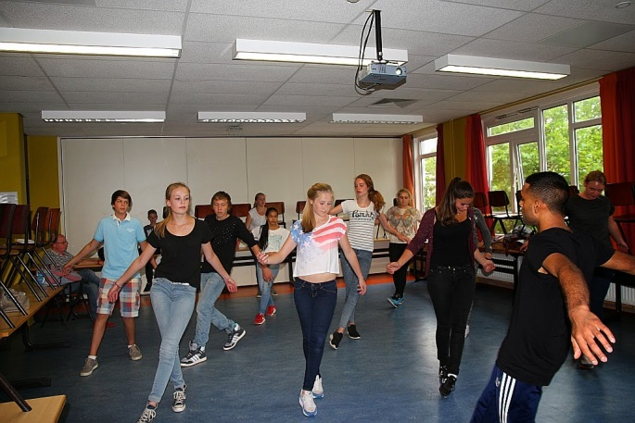
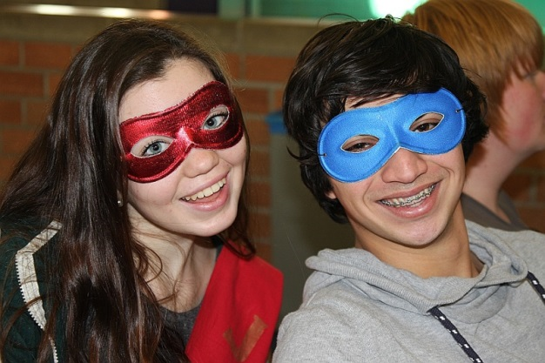
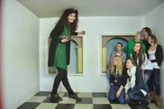

Slide 6
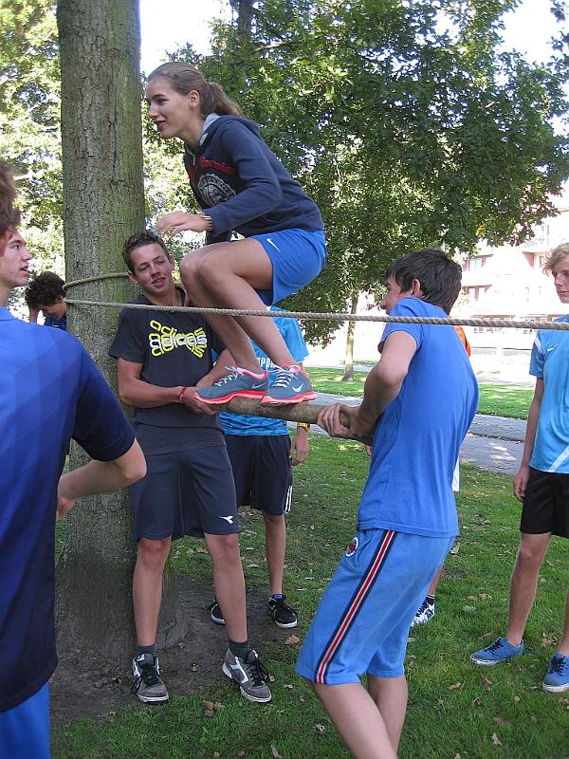
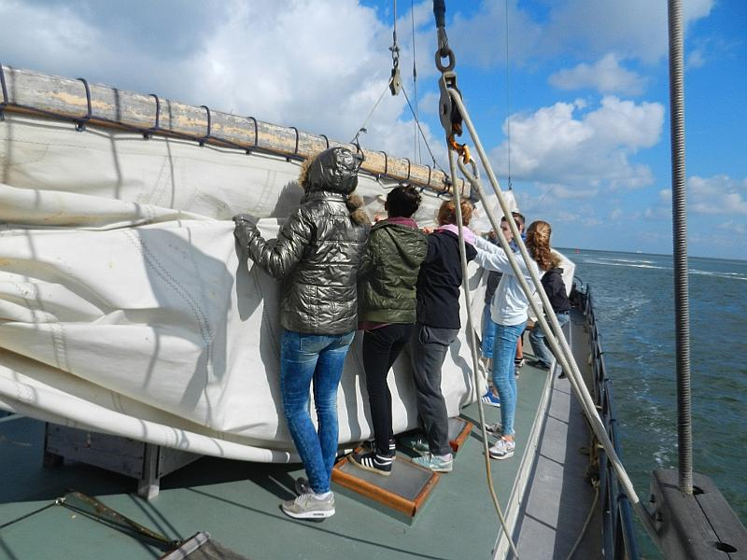
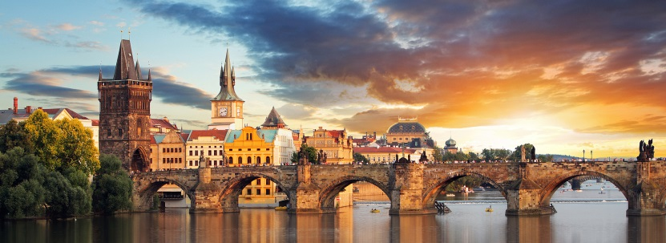
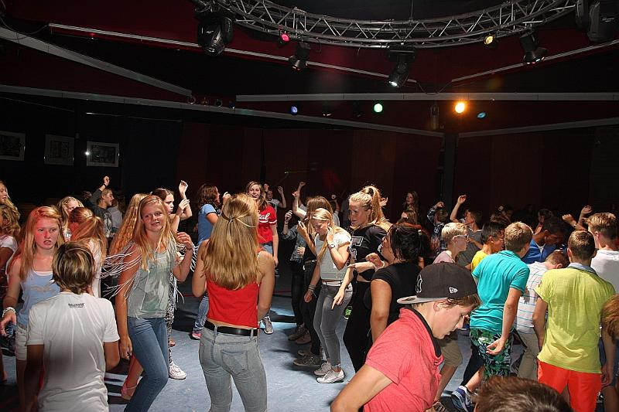
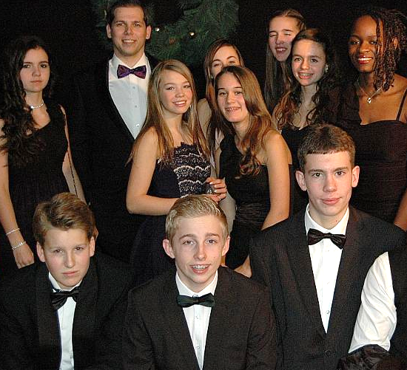


Slide 7
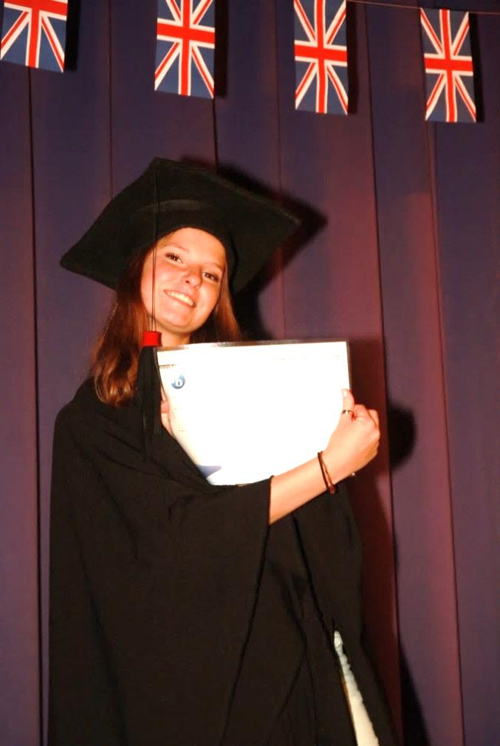
Bilingual Education
at

Slide 8


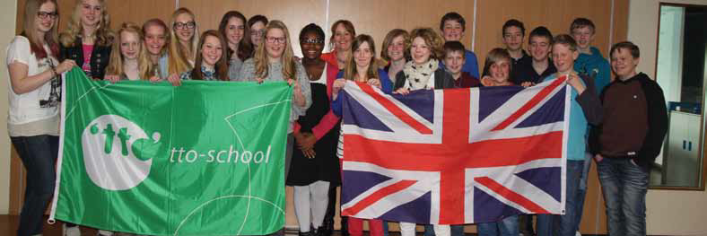
Bilingual Education
= Content and Language Integrated Learning (clil)
= Tweetalig Onderwijs (tto)
landelijk netwerk voor tweetalig onderwijs
At JL: 1998 – vwo Audit & Certificate
2003 – havo every 5 years

Slide 9

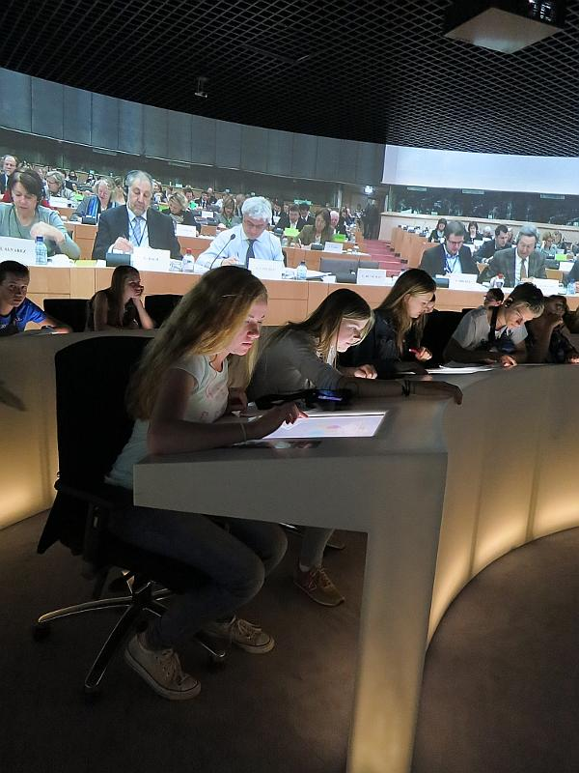
tto Language
+
EIO & Internationalisation
Internationalisation projects
EU-project;
Model UN;
Pro Demos;
European Parlement
meeting and working
with students/professionals
from abroad

Slide 10
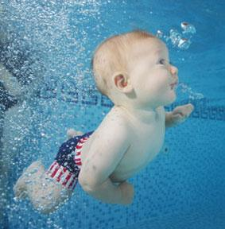
Language: learning by immersion

Slide 11
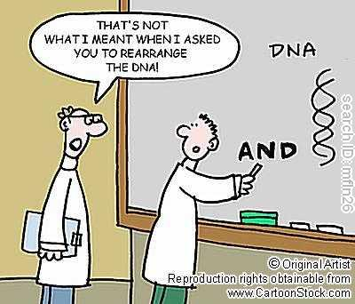
Junior school: year 1, 2, 3 - min. 50% taught in English
English
Life Studies
Geography
History
Mathematics
Physical Education
Art & Culture
Social Health and Fitness
Computer Skills
Biology
Physics
Economics
Chemistry
Not in English:
Dutch
French
German
Latin
Greek

Slide 12

Senior school: year 4, 5,(6) ± 25% English
IB English
Life studies
Art and Culture
Social Studies
Internationalisation
Science for Public Understanding
Drama
Final thesis
International School Trip
International Internship

Slide 13


Extra certificates and diplomas
Junior School - Junior Certificate European Platform
- Cambridge English Language Assessment
havo: level B2 CEFR for languages
vwo: level C1
Senior School - Senior Certificate EP
- International Baccalaurate
havo: English B
vwo: English A Lang & Lit

Slide 14
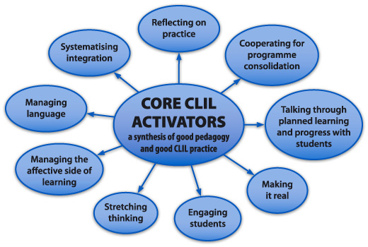
Teachers
Cambridge Certificate of Proficiency in English
Clil-didactics
IB-training
Native speakers
EIO

Slide 15
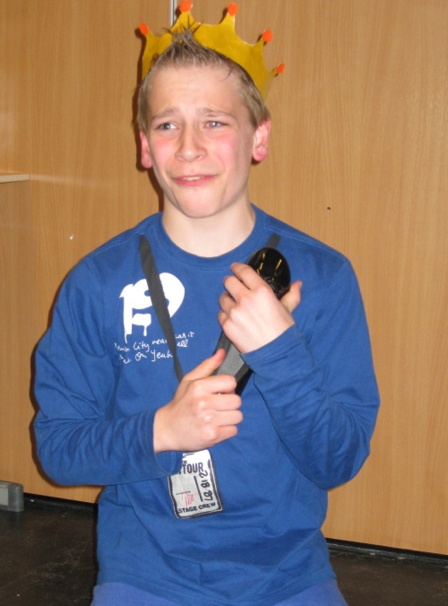
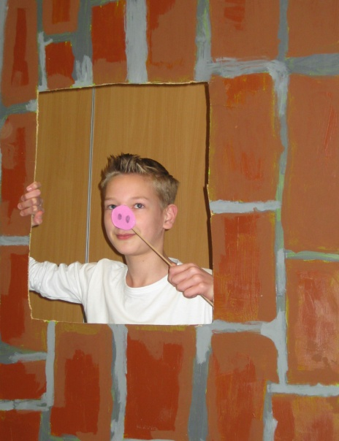
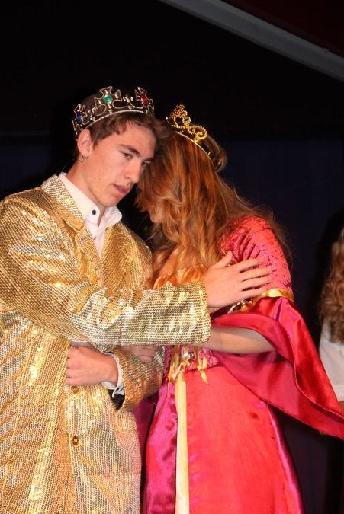
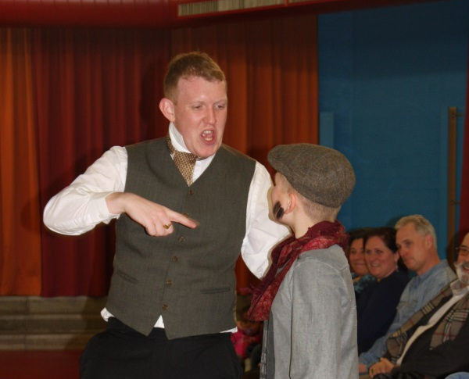
Drama

Slide 16
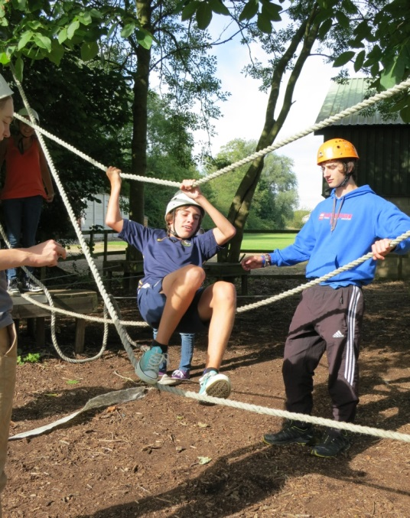
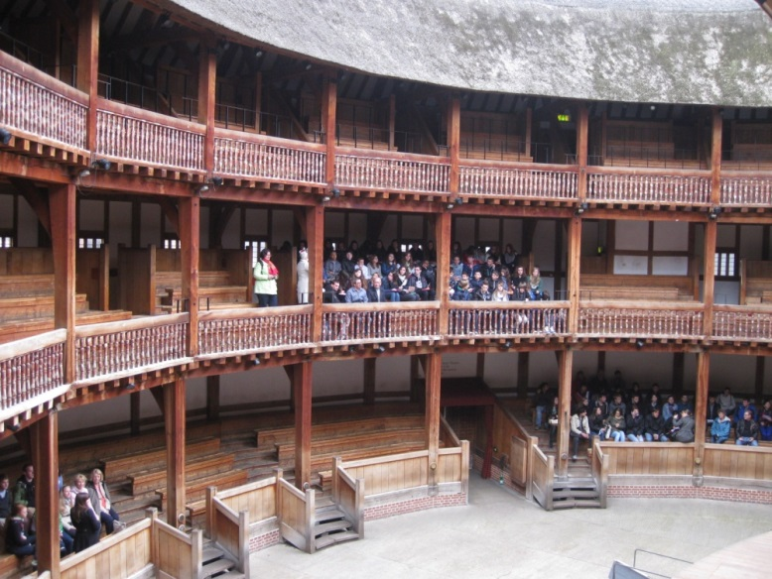
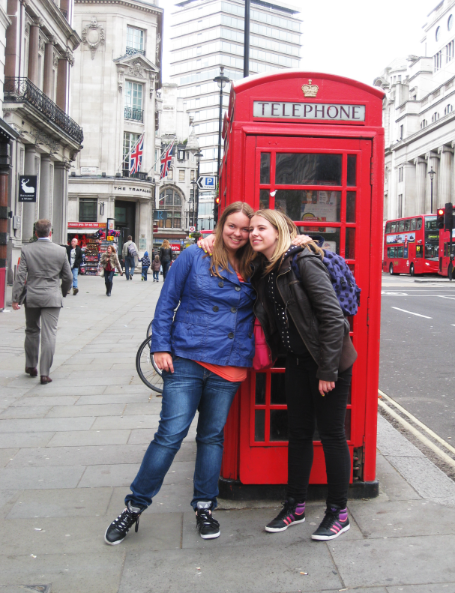
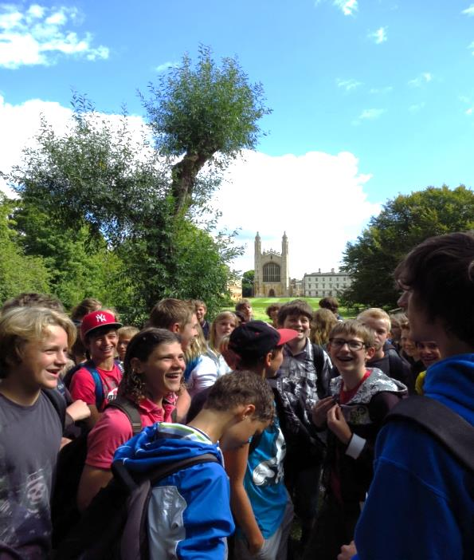
School trips
Year 4
London
Year 2
Cambridge

Slide 17
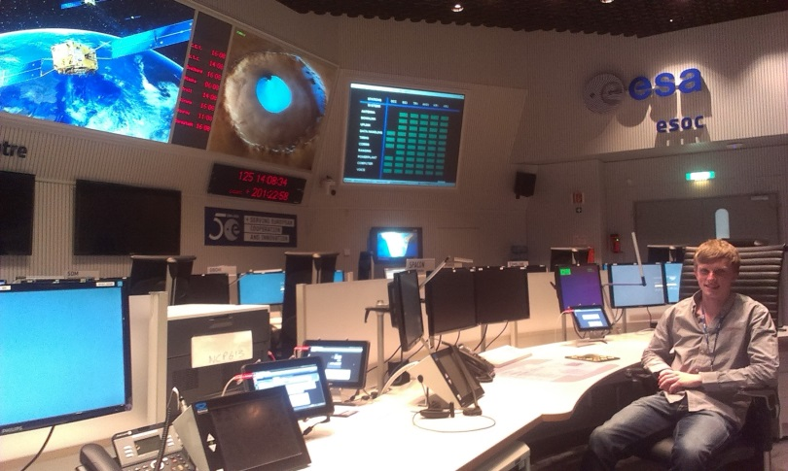

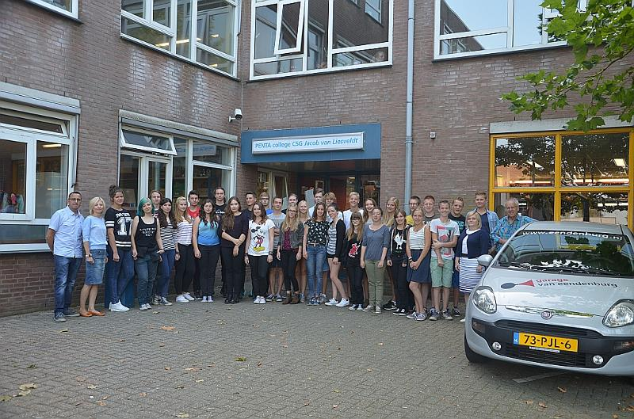
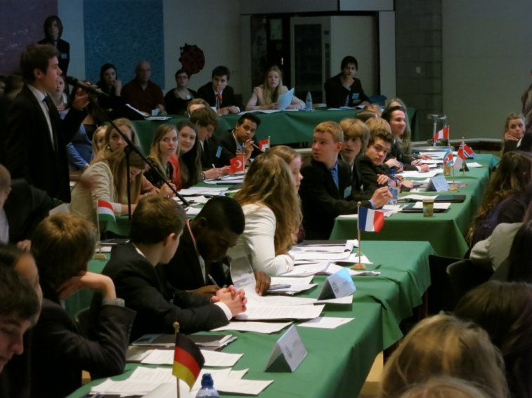
Internationalisation
Internship
year 5
Exchange Project
year 3
Internationalisation Project
(+ Exchange?) year 4/5
Model UN
year 5/6

Slide 18
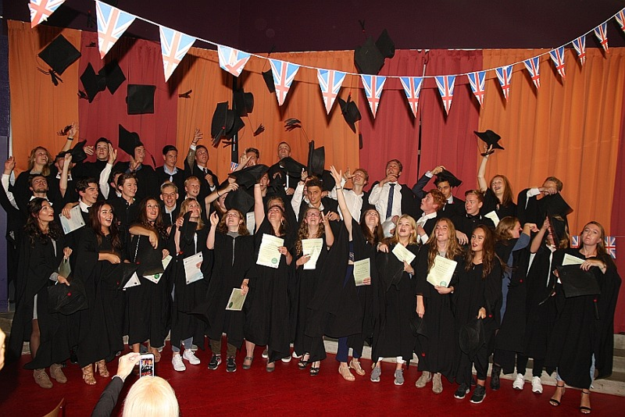
TTO!
The best of both worlds!

