Slide 1
Erasmus+ KA2
Finland December 2016
Video-making and life experiences

Slide 2
Introduction to language of cinema
Visual literacy
Camera-pen method
To utilise images and videos as communication tools as powerful, creative and precise as writing.

Slide 3

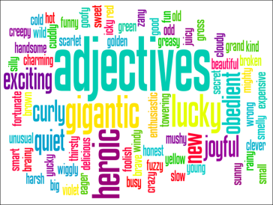
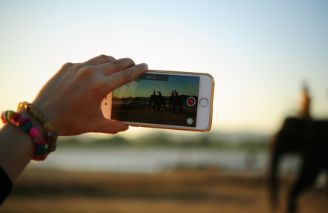
Process
Observe
Communicate
Express

Slide 4

Mind copyright standards
Right to originality: creator of an original work has an exclusive right to own it and distribute it.
Standard Copyright Licence
Creative Commons
Some rights reserved
The creator decides …

Slide 5




Some types of copyright licences
BY (ATTRIBUTION) | You must tell the name of the creator
NC (NON-COMMERCIAL) | You must utilise the work only for non-commercial purposese
ND (NO DERIVATIVE WORKS) | You mustn’t modify the work of the creator
SA (SHARE-ALIKE) | You must share derivative works only with the identical licence of the original work

Slide 6
Ethics of visual journalism
Journalism: objective and responsible
Primary goal: faithful and comprehensive depiction of the subject at hand
Code of ethics
Objective information;
No stereotypes;
Respect and dignity ( special consideration for vulnerable subjects and compassion for victims of crimes or tragedies), (private moments only when it is necessary);
No depiction of other events;
Editing shall mantain integrity of pictures (not to modify in order to change meanings);
No pay to film or photograph subjects;

Slide 7
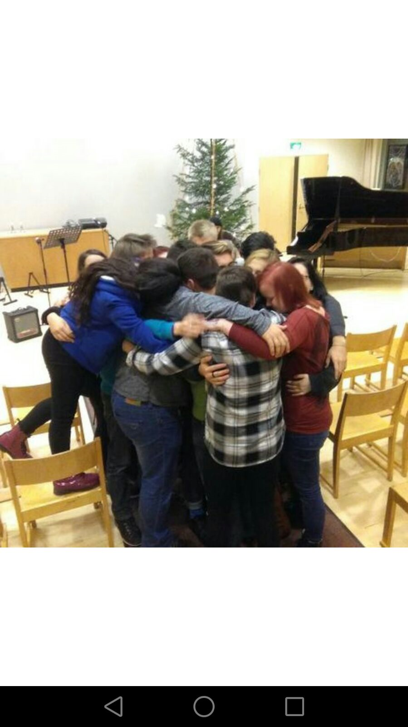
Sharing experiences…

