Slide 1
VIDEO MASHING ACTIVITY
ERASMUS KA2 PROJECT “THE EUROPEAN NEWSROOM”
LICEO STATALE A. MANZONI –CASERTA
TEACHER: EMMA ABBATE

Slide 2
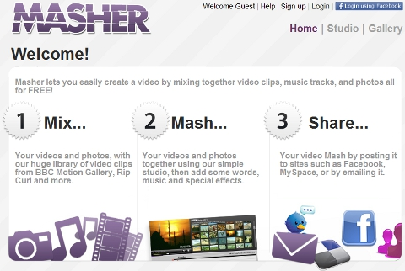
MAKE IT FAIR USE OR COPYRIGHT COMPLIANT
Using copyrighted materials or Creative Commons licensed content, create a Remix Video. Use http://www.masher.com. Masher is a free, easy-to-use video remix tool that offers “royalty free” (public domain) music and video content from the British Broadcasting Corporation (BBC).
Additional materials can be found via sites onthe Village.Symbaloo.com Multimedia page. These images, video, and music can be uploaded to masher.com and remixed using the “Studio” editing tool. You may also use the royalty-freecontent on Masher.com. Work in team

Slide 3

STEPS FOR MASHING ACTIVITY
Login to Masher.
2.Watch the tutorial video.
3.Watch two Mashes from the gallery.
4.Identify purpose of your video, the target audience, and topic choice.
5.Begin gathering media. Create a 1-2 minute video using masher.com that includes:special effects,
music, text, videos, and photographs.
6.Organize photos, videos, and other media
7.Create text to match photos
8.Add in effects and skins
9.Embed music
10. Compile and save video
11. Write a justification as to why your video meets copyright and fairuse guidelines.
12. Share remix videos with other teams

Slide 4
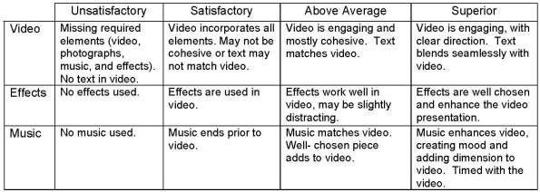
EVALUATE YOUR FRIENDS’ WORK
USING THE GIVEN RUBRIC EVALUATE YOUR FRIENDS’ MASHED VIDEOS.

