Slide 1
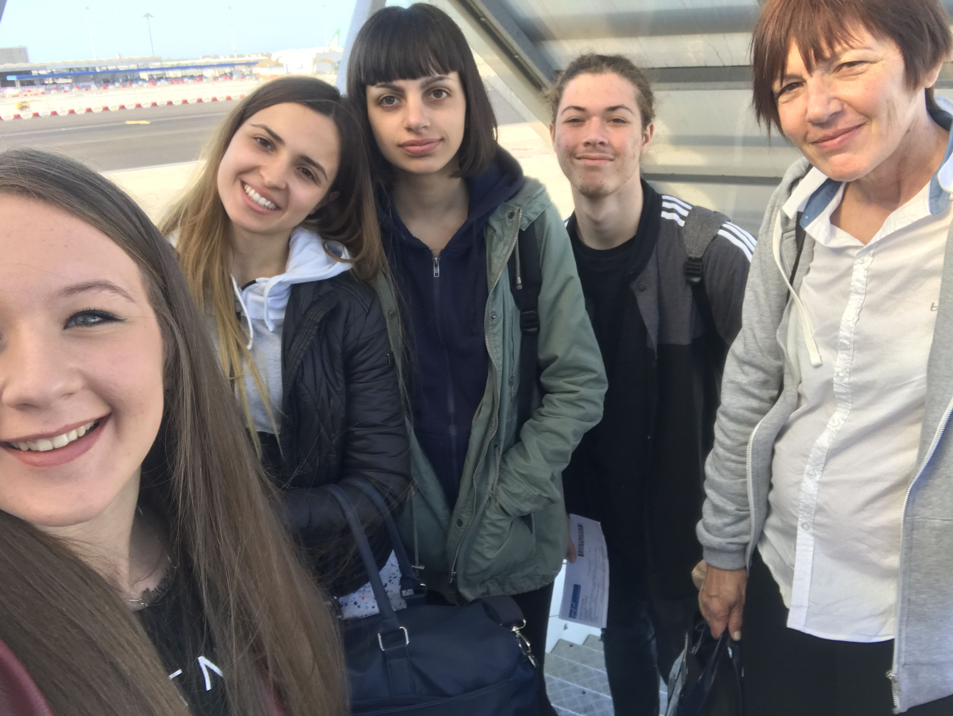
Here started our trip to Romania

Slide 2
VIDEO JOURNALISM
Form of journalism where the journalist shoots, edits and often presents his own video material
A predecessor to video journalism first appeared in the 1960s in the USA, when reporters had to write and shoot their own stories. Michael Rosenblum compared the introduction of video cameras to the invention of the portable camera in the 1930s. The concept of the Videojournalist using a small camera was invented by Michael Rosenblum in 1988

Slide 3
ISSUES:
Copyright which can be difficult to obtain when broadcasters and agencies insist on full ownership of the footage
Others see this method of production as a dilution of skills and quality driven by television network management cost cutting incentives
trying to find distribution beyond established contacts
Advantages:
Video journalism makes it possible for videographers to document any event while it is still occurring
Is easier to learn and understand something with video journalism

Slide 4
News story
To realise a news story we have to use 5 «W» and the «H»
Who?
What ?
Where?
When?
Why?
How?
Answers give informations about events like wars, government, education, health, environment, economy, business.

Slide 5
Most stories can be presented using a particular angle or «slant», it can help make the purpose of the story clear and give it focus.
It has an objective, it’s completely impartial
It covers all sides of the story
Keep senteces and paragraphs short

Slide 6
Interview
This word refers to one-on-one conversation with one person acting in the role of the interviewer and the other in the role of the interviewee.
The interviewer asks questions, the interviewee responds, with participants taking turns talking. Interviews usually involve a transfer of information from interviewee to interviewer, which is usually the primary purpose
It usually takes place face to face and in person, although modern communications technologies such as the Internet

Slide 7
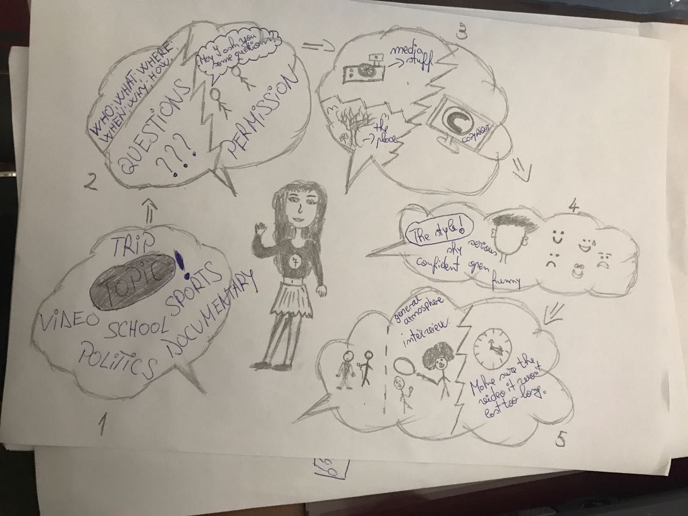
STORYBOARD
Is a graphic organizer in the form of illustrations or images displayed in sequence for the purpose of pre-visualizing a motion picture, animation, motion graphic or interactive media sequence. The storyboarding process, in the form it is known today, was developed at Walt Disney Productions during the early 1930s, after several years of similar processes being in use at Walt Disney and other animation studios.

Slide 8
Shot definition and cameramovements
Long shot : person is completely in the picture
Medium long shot: person is half in the picture
Medium shot: person is for one-third in the picture
Close up: person is for one-quarter in the picture
Single shot: only one person in the picture
Two shot: two people in the picture
Three shot: three people in the picture
Over the shoulder shot: shoulder is involved

Slide 9
Angles shots
Low angle shot: the camera is in a low position and looks up at a person giving him more authority
High angle shot: the camera is at a high position and looks down on a person making him look weaker and less authoritative

Slide 10
Sound the sound can be an important reason for a particulary shot or transition. For example if someone enters the room in the middle of a discussion, everyone will look up at the new person. So, when recording the viewer will expect at least a mid or long shot from that person. If not, the viewer will get the feeling of exclusion
SHOTS the framing of shots is normally determined by what’s happening in front of the camera. That is to say, if it is uninteresting or unimportant a wide shot can be appropriate. But if it’s interesting or important, a closer shot will work better
Composition in case of a single shot from a person, if the subject is looking to the right, make the composition of the shot with that person, a little bit off-center to the left of the screen, to give that person some space to look at/in

Slide 11
Lightning
Why do we use light? It takes time toset up, it generates heat, it’s bulky and nowdays CCD-camera’s are so sensitive that most of the time the available light is sufficient. Sometimes we need it indoors, outdoors or we don’t need it.
Hard light
It gives a sharp picture that has «body». Most objects well get dull and uninteresting if only lighted with soft or flat light.
Soft light
Usually used to lower the high contrast from the hard lights. But it can be used as a light on its own too.
Without soft light some impressionable effects are unable to make

